Slide 1
Chapter 9: Value-Returning Functions

Slide 2
Objectives
Raise a number to a power using the pow function
Return the square root of a number using the sqrt function
Generate random numbers
Create and invoke a function that returns a value
Pass information by value to a function
Write a function prototype
Understand a variable’s scope and lifetime

Slide 3
Functions
A function is a block of code that performs a task
Every C++ program contains at least one function (main)
Most contain many functions
Some functions are built-in functions (part of C++): defined in language libraries
Others, called program-defined functions, are written by programmers; defined in a program
Functions allow for blocks of code to be used many times in a program without having to duplicate code

Slide 4
Functions (cont’d.)
Functions also allow large, complex programs to be broken down into small, manageable sub-tasks
Each sub-task is solved by a function, and thus different people can write different functions
Many functions can then be combined into a single program
Typically, main is used to call other functions, but any function can call any other function

Slide 5
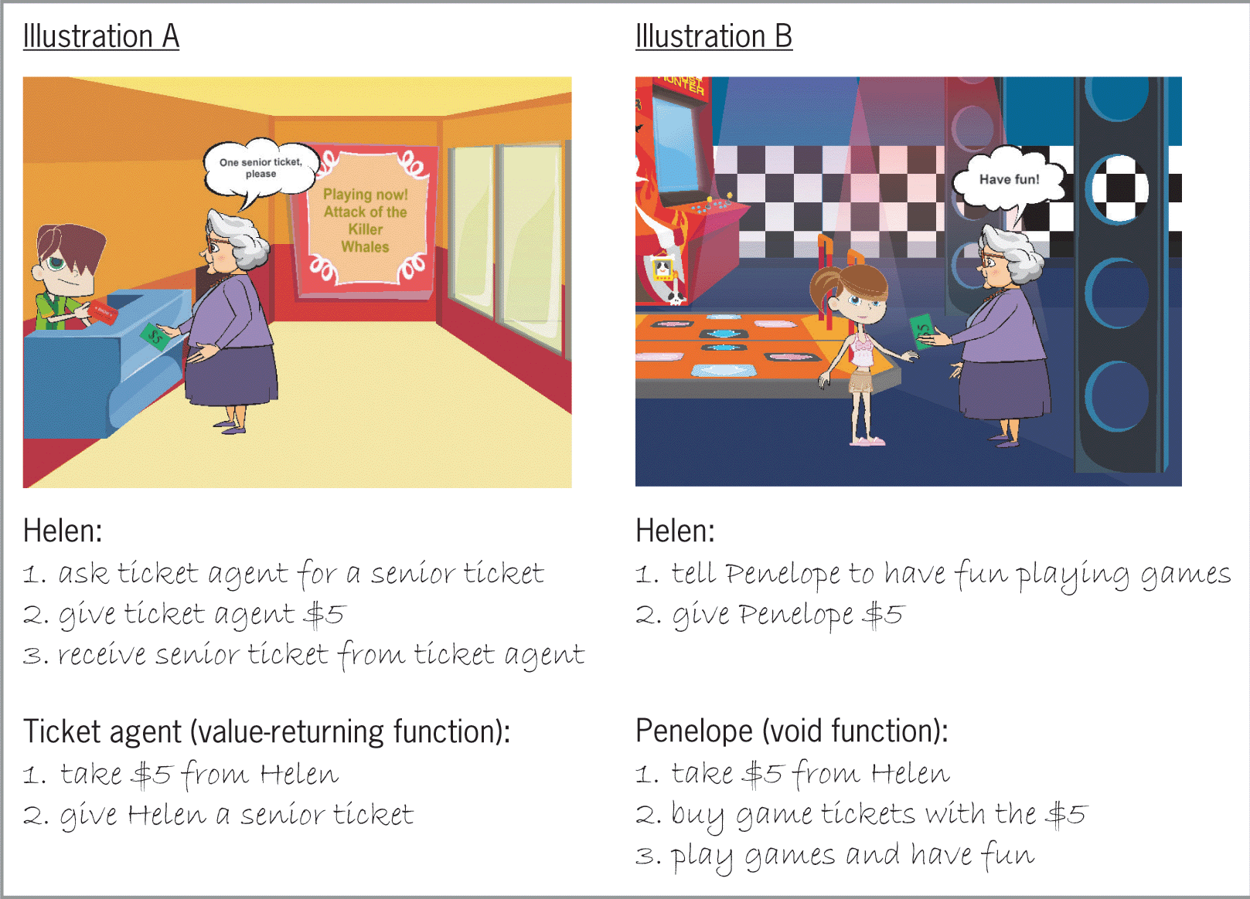
Functions (cont’d.)
Figure 9-1 Illustrations of value-returning and void functions

Slide 6
Value-Returning Functions
All functions are either value-returning or void
All value-returning functions perform a task and then return precisely one value
In most cases, the value is returned to the statement that called the function
Typically, a statement that calls a function assigns the return value to a variable
However, a return value could also be used in a comparison or calculation or could be printed to the screen

Slide 7
The pow Function
The pow function is a convenient tool to raise a number to a power (exponentiation)
The pow function raises a number to a power and returns the result as a double number
Syntax is pow(x, y), in which x is the base and y is the exponent
At least one of the two arguments must be a double
Program must contain the #include <cmath> directive to use the pow function

Slide 8
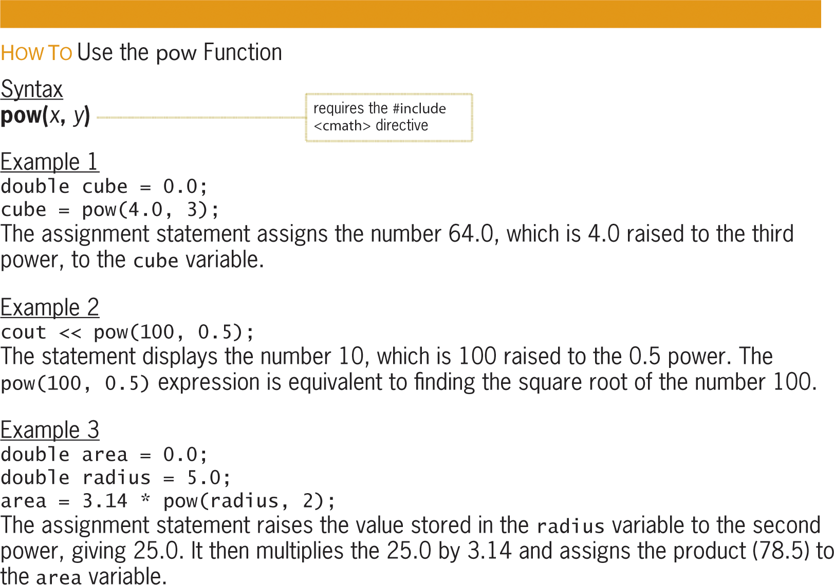
The pow Function (cont’d.)
Figure 9-2 How to use the pow function

Slide 9
The sqrt Function
sqrt function is a built-in value-returning function that returns a number’s square root as a double
Definition contained in cmath library
Program must contain #include <cmath> to use it
Syntax: sqrt(x), in which x is a double or float
Here, x is an actual argument, which is an item of information a function needs to perform its task
Actual arguments are passed to a function when called

Slide 10
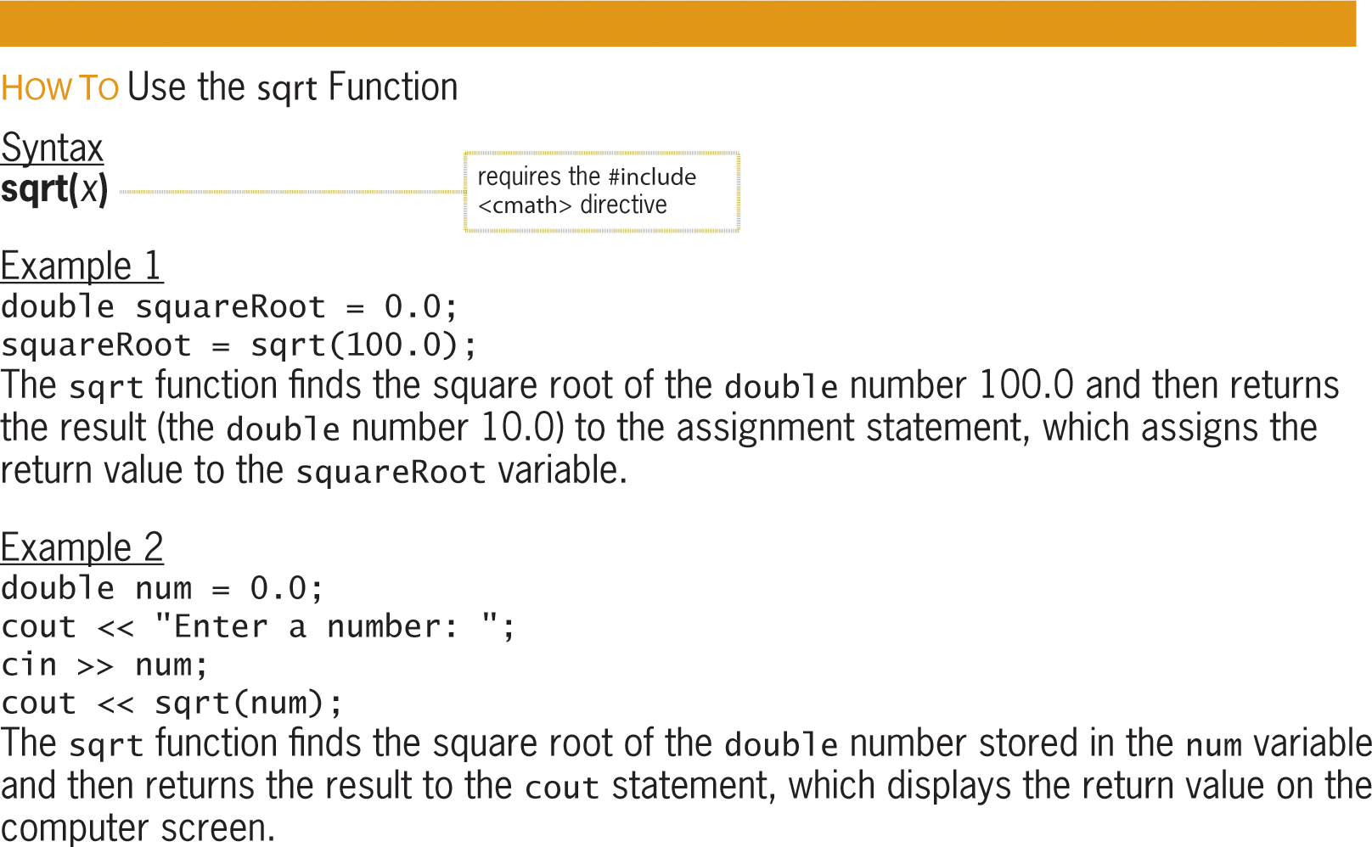
The sqrt Function (cont’d.)
Figure 9-3 How to use the sqrt function

Slide 11
The Hypotenuse Program
Program that calculates and displays the length of a right triangle hypotenuse
Program uses Pythagorean theorem
Requires squaring and taking square root
pow function can be used to square
sqrt function can be used to take square root
Both are built-in value-returning functions

Slide 12
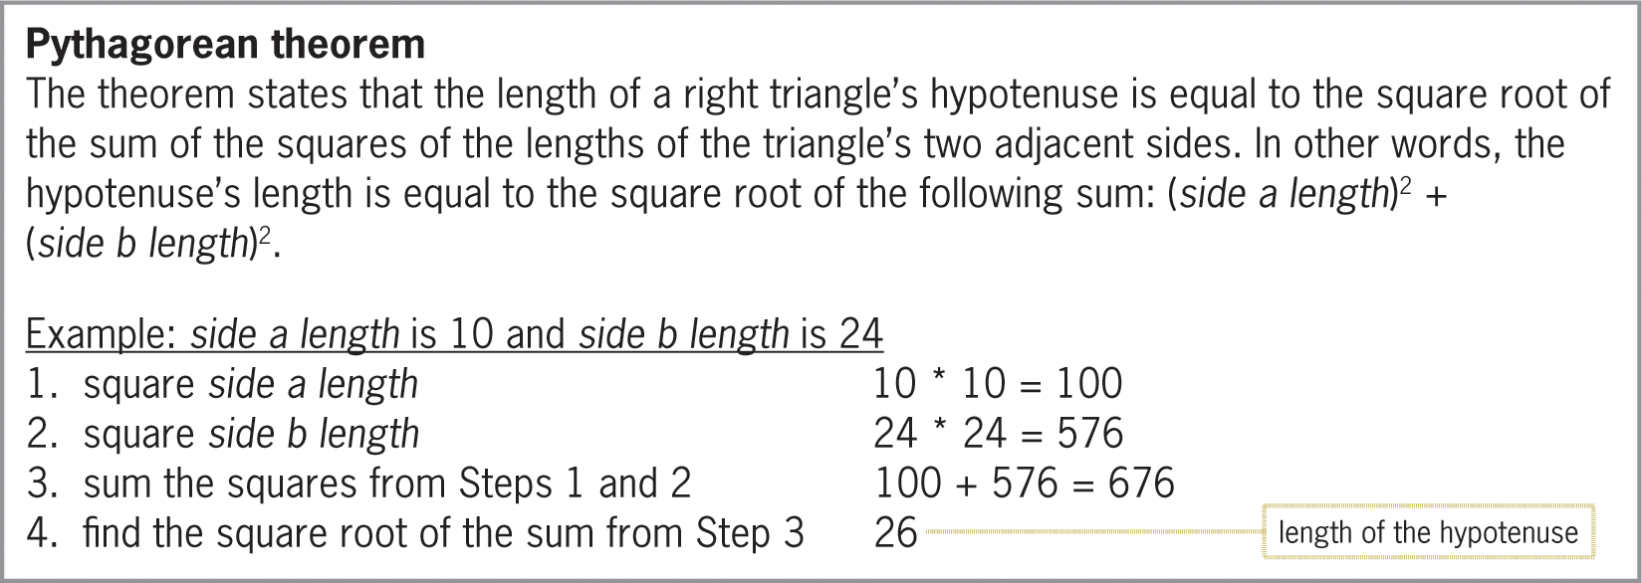
The Hypotenuse Program (cont’d.)
Figure 9-4 Pythagorean theorem

Slide 13
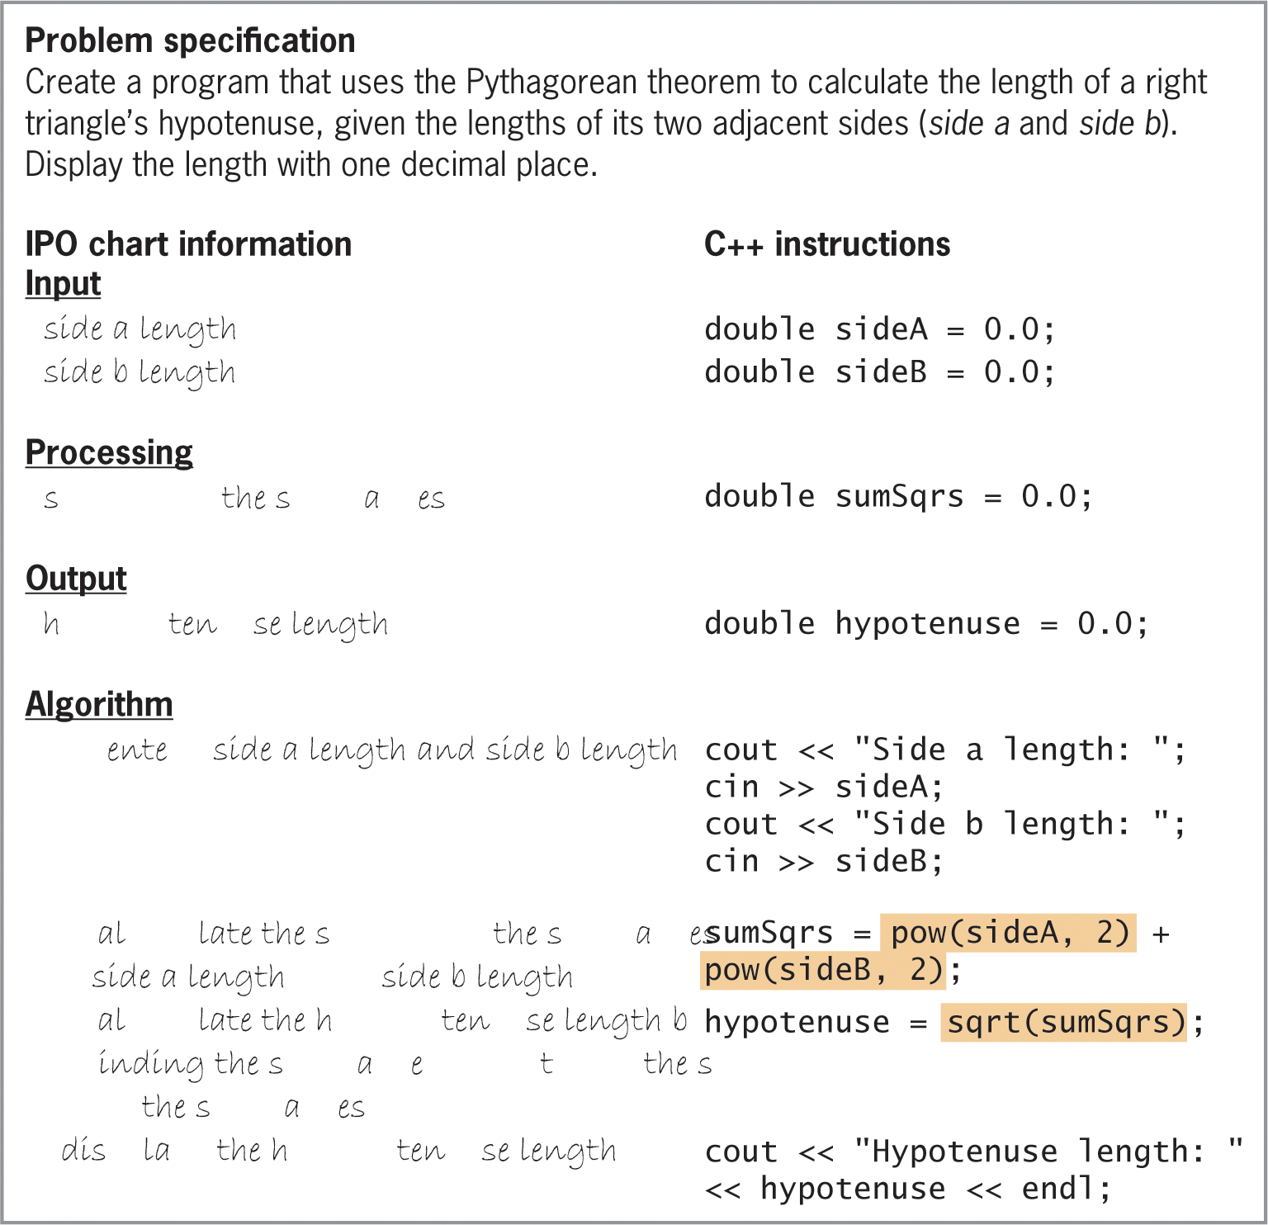
The Hypotenuse Program (cont’d.)
Figure 9-5 Problem specification, IPO chart information, and C++ instructions for the Hypotenuse Program

Slide 14
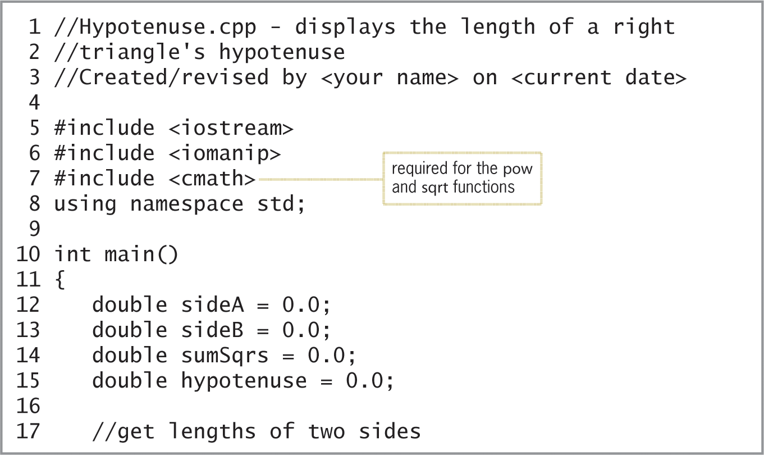
The Hypotenuse Program (cont’d.)
Figure 9-6 Beginning of Hypotenuse program

Slide 15
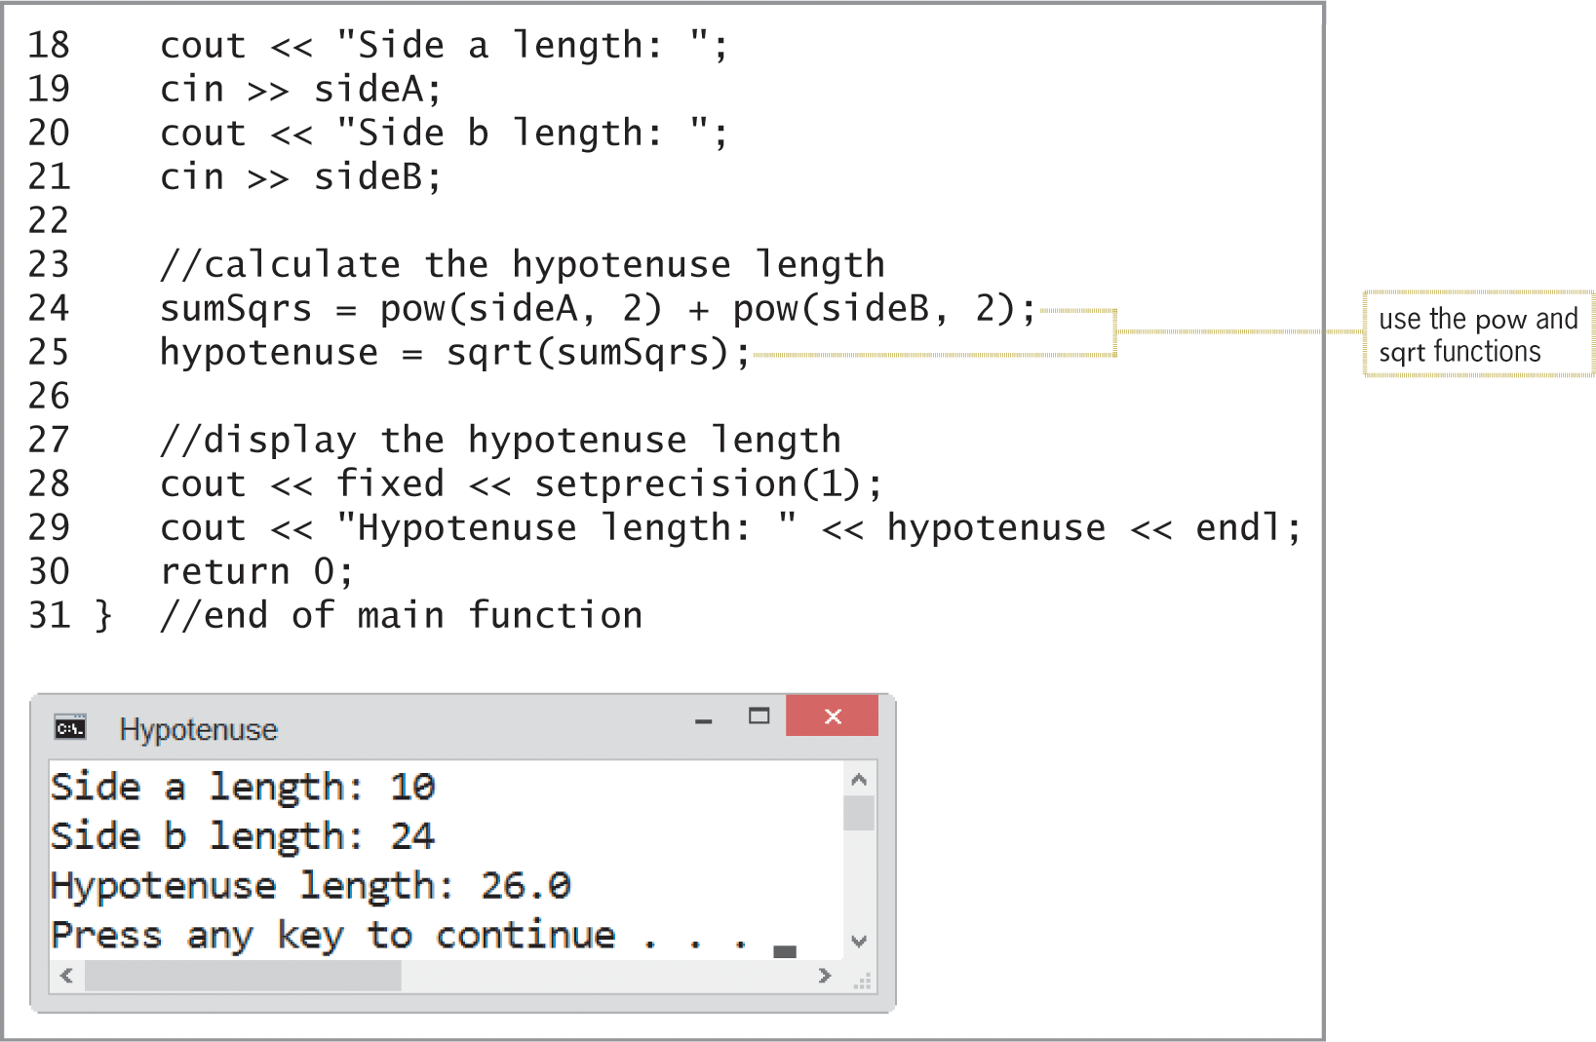
The Hypotenuse Program (cont’d.)
Figure 9-6 Completion of Hypotenuse Program and sample run

Slide 16
The rand, srand, and time Functions
C++ provides a pseudo-random number generator
Produces a sequence of numbers that meet certain statistical requirements for randomness
Numbers chosen uniformly from finite set of numbers
Not truly random but sufficient for practical purposes
Random number generator in C++: rand function
Returns an integer between 0 and RAND_MAX, inclusive
RAND_MAX is a built-in constant (>= 32767)

Slide 17
The rand, srand, and time Functions (cont’d.)
rand function’s syntax: rand()
Doesn’t require any actual arguments, but parentheses are still required
Expression:
lowerBound + rand() % (upperBound – lowerBound + 1)
Allows ranges other than 0 to RAND_MAX to be used
Range is upperBound to lowerBound
Initialize random number generator each time
Otherwise, will produce the same sequence

Slide 18
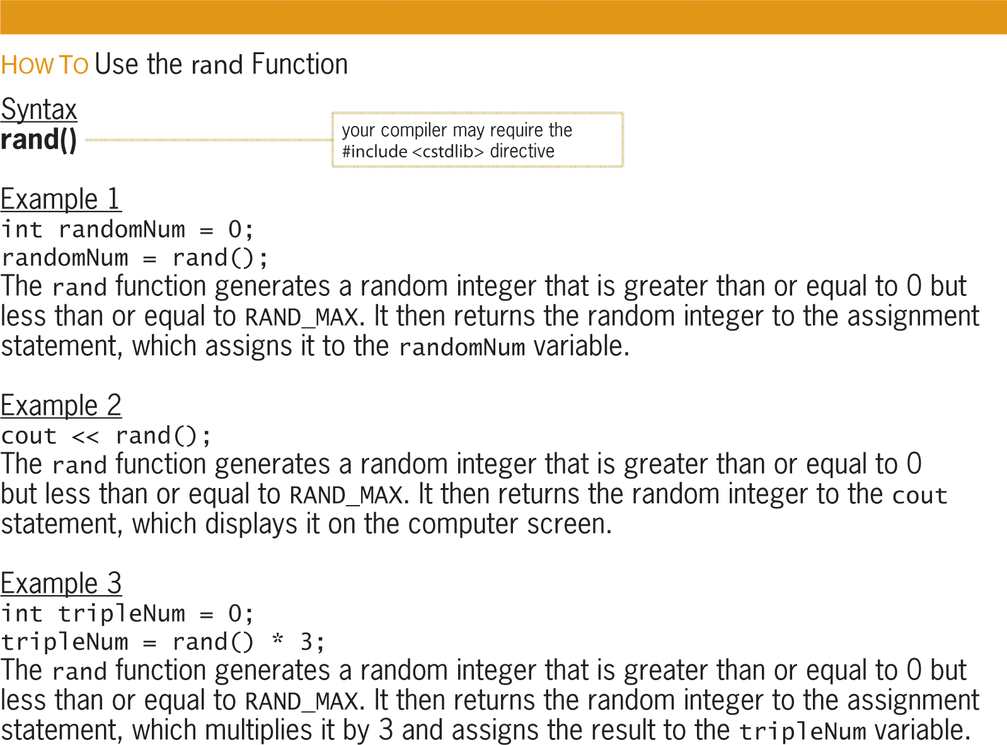
The rand, srand, and time Functions (cont’d.)
Figure 9-7 How to use the rand function

Slide 19
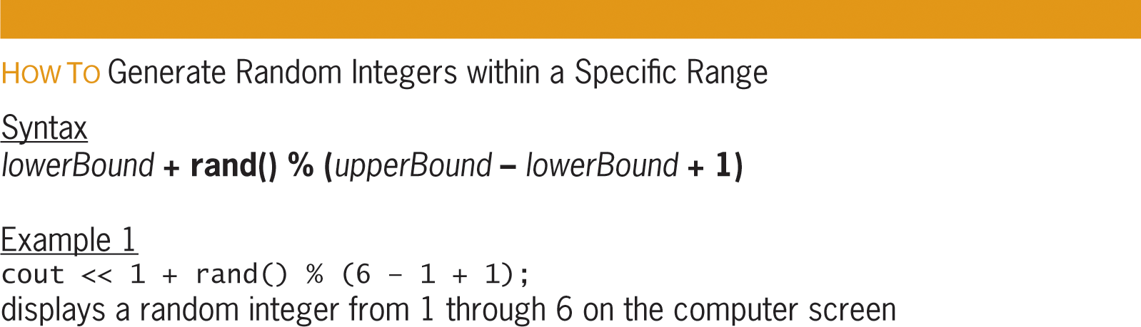
The rand, srand, and time Functions (cont’d.)
Figure 9-8 How to generate random integers within a specific range

Slide 20
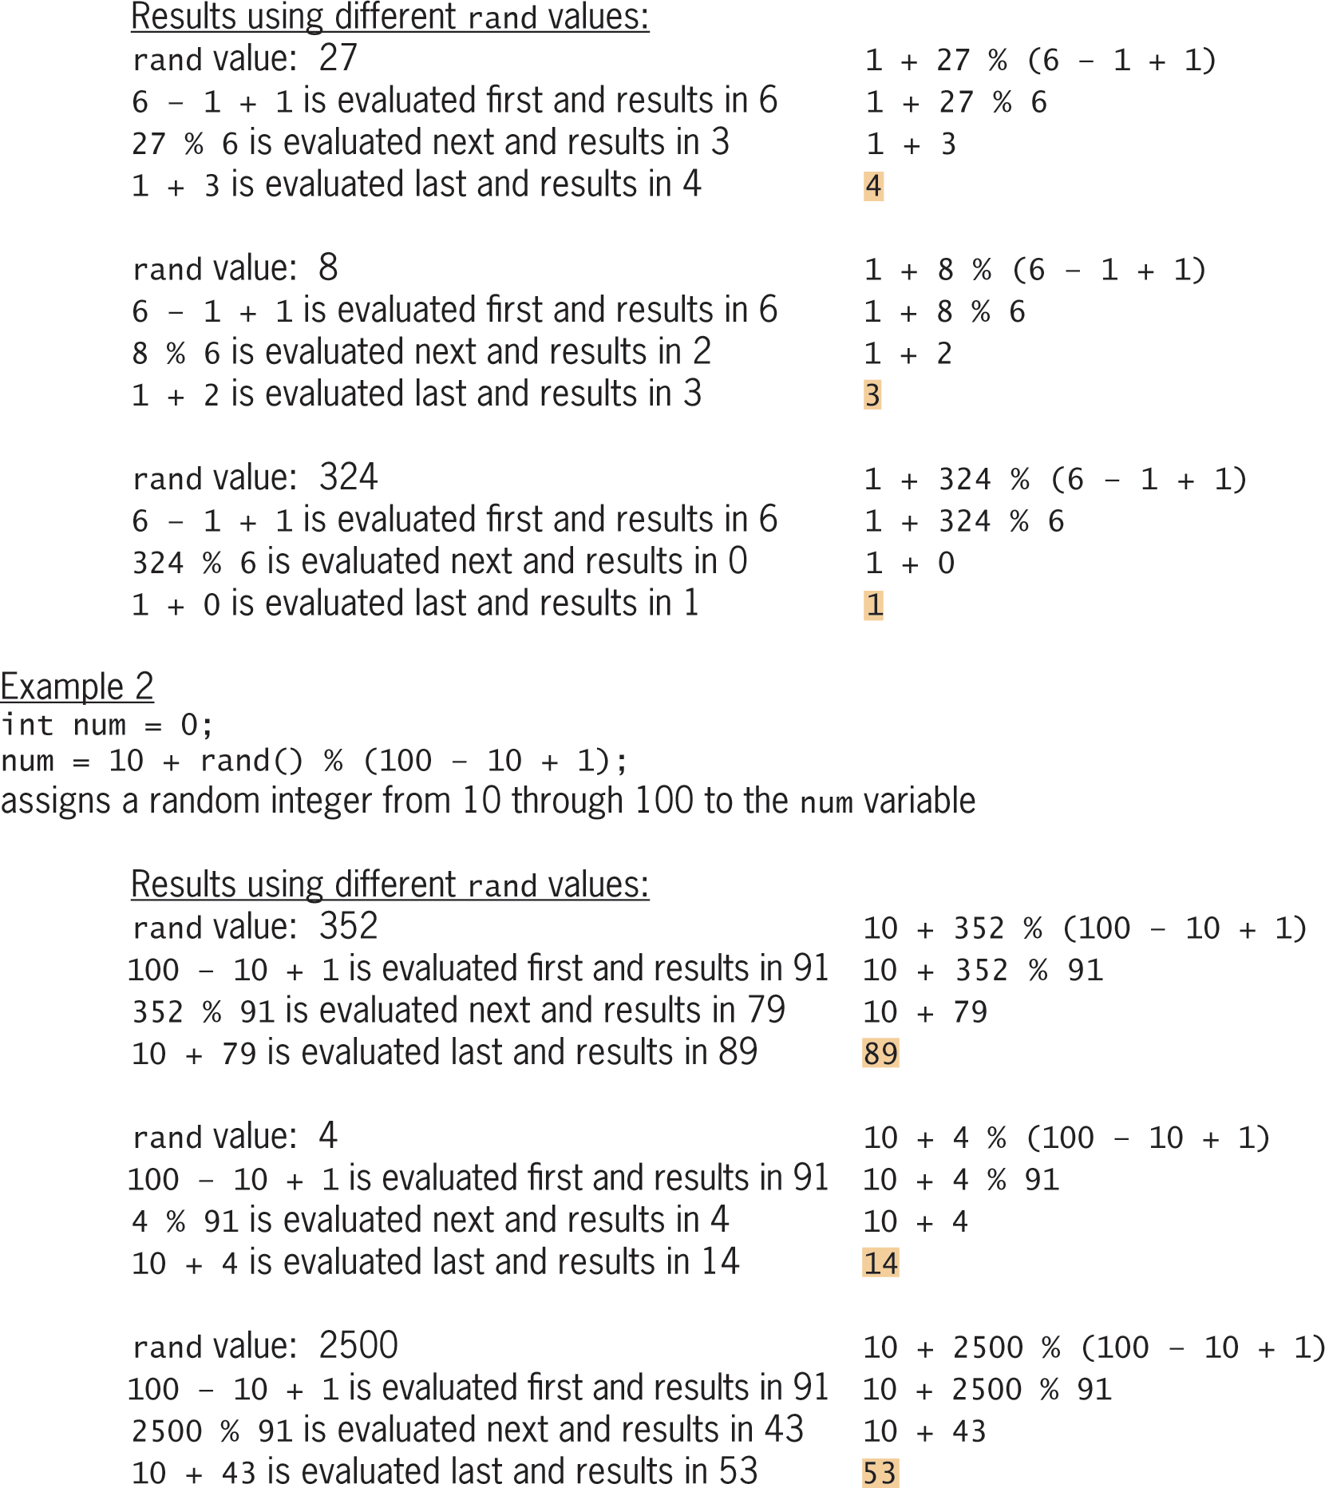
The rand, srand, and time Functions (cont’d.)
Figure 9-8 How to generate random integers within a specific range

Slide 21
The rand, srand, and time Functions (cont’d.)
Use srand function (a void function) to initialize random number generator
Syntax: srand(seed), in which seed is an integer actual argument that represents the starting point of the generator
Commonly initialized using the time function
Ensures unique sequence of numbers for each program run

Slide 22
The rand, srand, and time Functions (cont’d.)
time function is a value-returning function that returns current time in number of seconds since January 1, 1970
Returns a time_t object, so must be cast to an integer before passing to srand
Program must contain #include <ctime> directive to use it

Slide 23
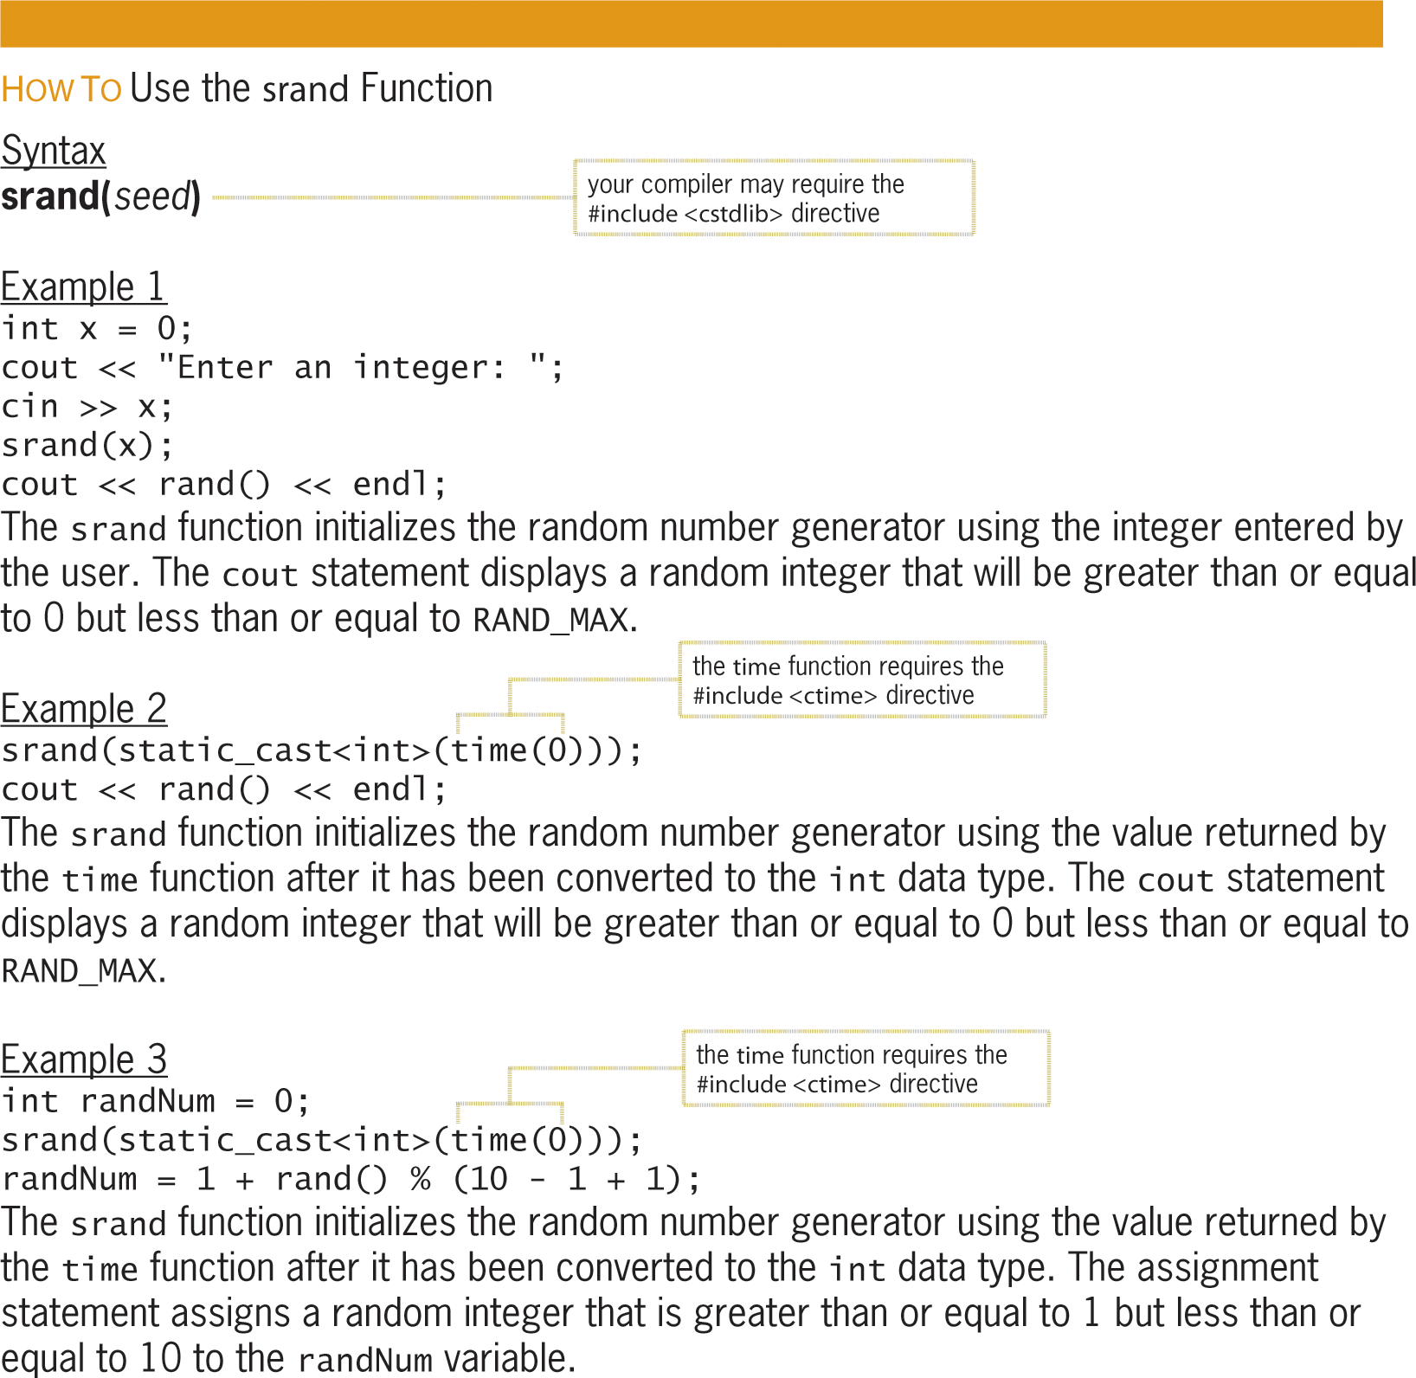
The rand, srand, and time Functions (cont’d.)
Figure 9-9 How to use the srand function

Slide 24
The Guessing Game Program
Program generates a random number from 1 to 10 and then allows the user as many choices as needed to guess the number.
The srand, time, and rand functions are all utilized in the program.

Slide 25
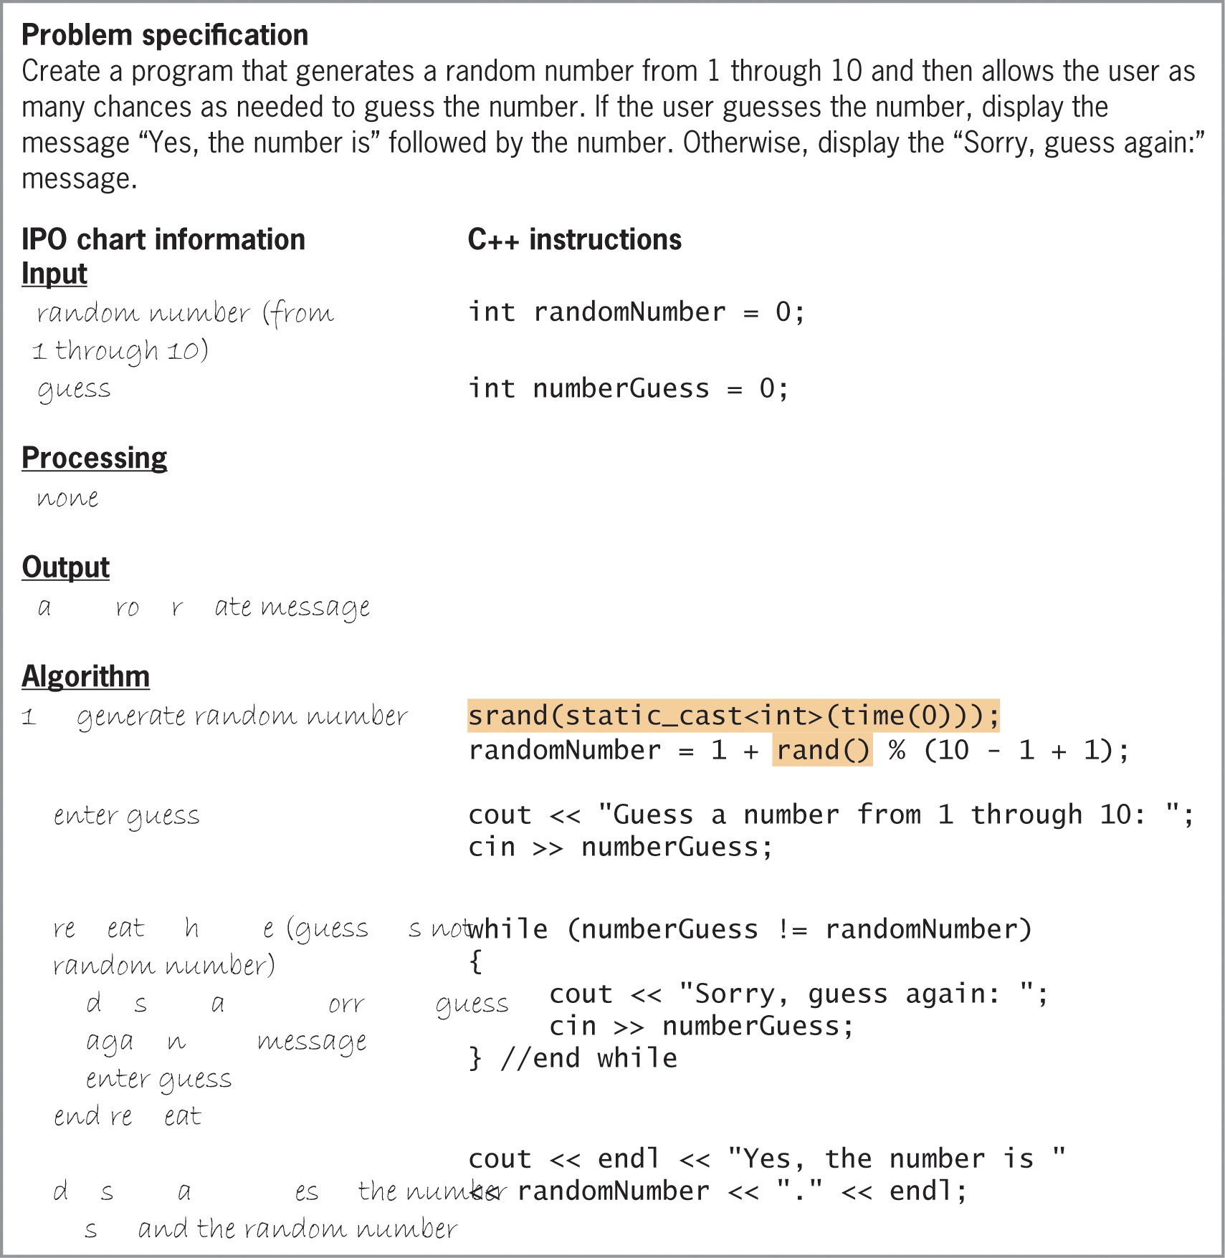
The Guessing Game Program(cont’d.)
Figure 9-10 Problem specification, IPO chart information, and C++ instructions for the Guessing Game Program

Slide 26
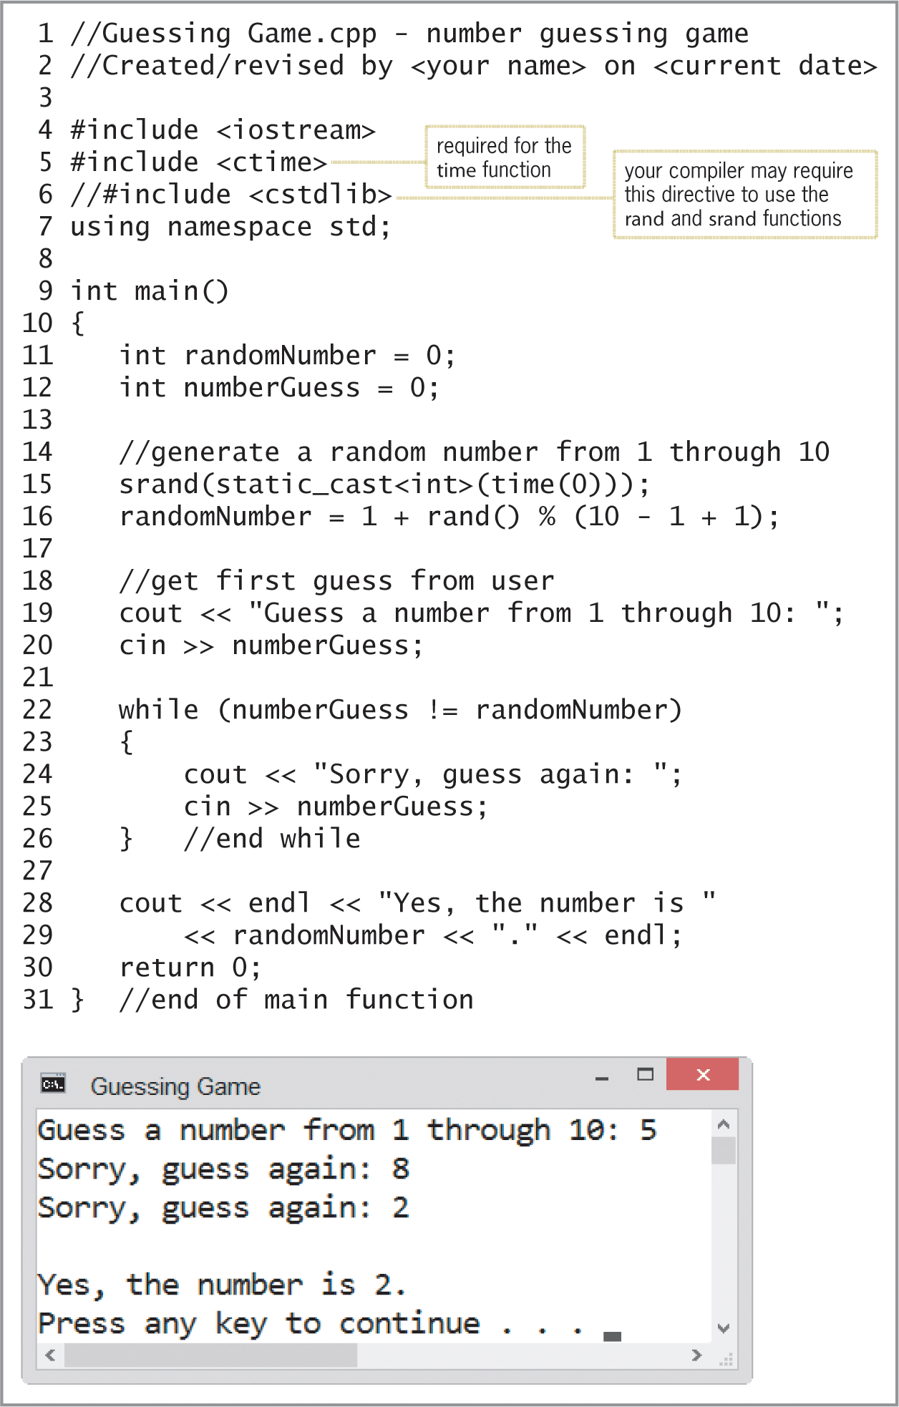
The Guessing Game Program(cont’d.)
Figure 9-11 Guessing Game Program and sample run

Slide 27
Creating Program-Defined Value-Returning Functions
A program-defined value-returning function definition is composed of a header and a body
Header (first line) contains return data type, name of function, and an optional parameterList
Rules for function names are same as for variables
Good idea to use meaningful names that describe function’s purpose
Memory locations in parameterList are called formal parameters
Each stores an item of information passed to the function when it is called

Slide 28
Creating Program-Defined Value-Returning Functions (cont’d.)
Function body contains instructions for performing the function’s assigned task
Surrounded by braces ({})
Last statement is usually the return statement
Returns one value (must match return data type in function header)
After return statement is processed, program execution continues in calling function
Good idea to include comment (such as //end of functionName) to mark end of function

Slide 29
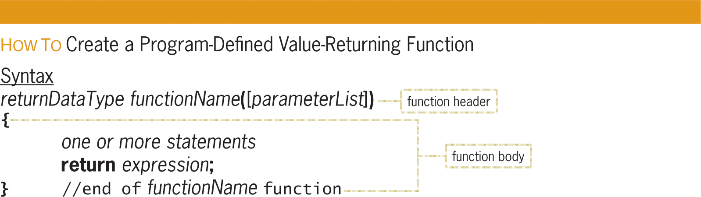
Creating Program-Defined Value-Returning Functions (cont’d.)
Figure 9-12 How to create a program-defined value-returning function

Slide 30
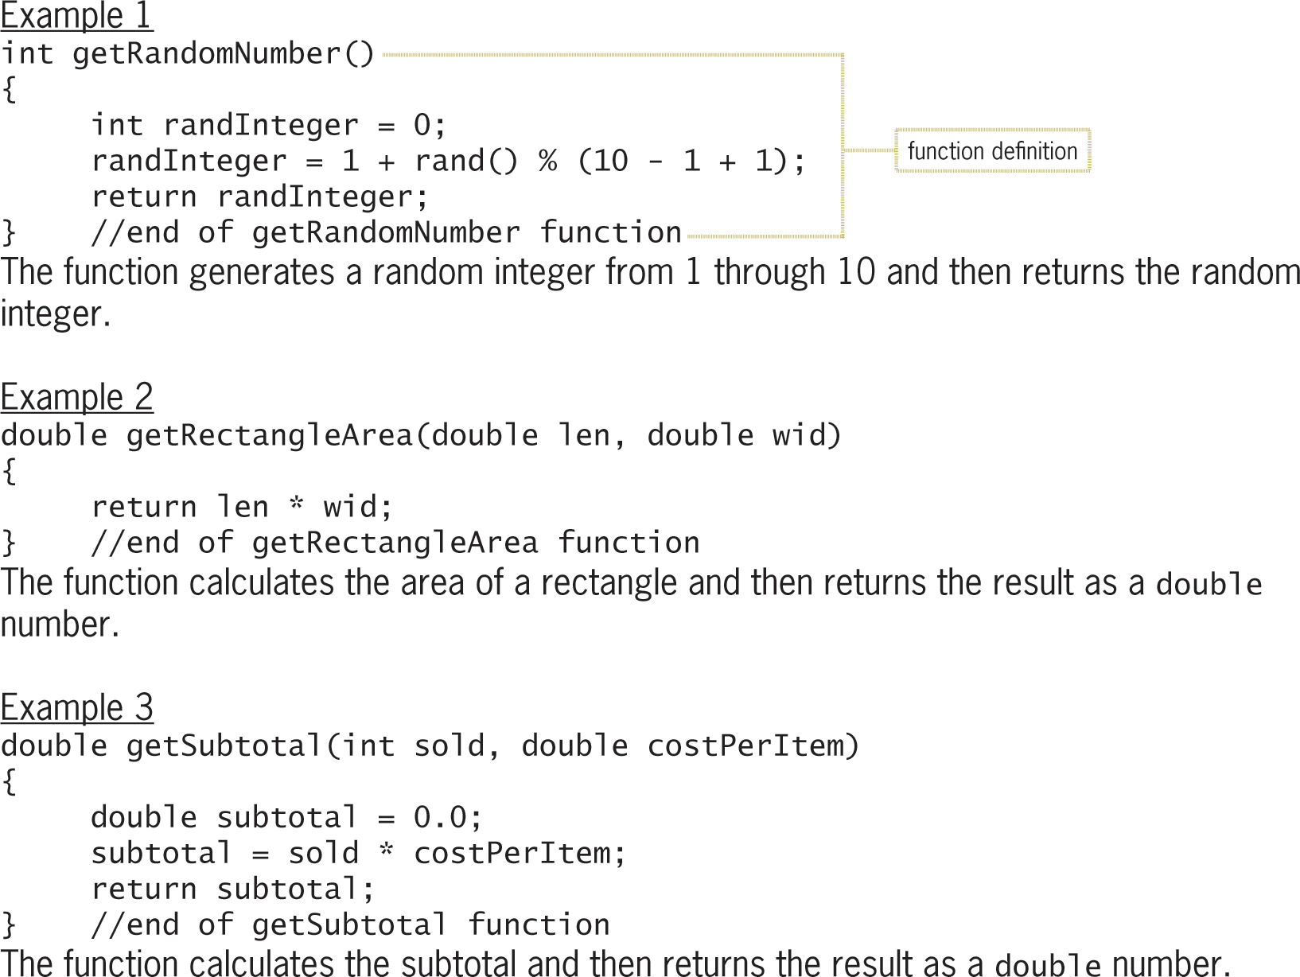
Creating Program-Defined Value-Returning Functions (cont’d.)
Figure 9-12 How to create a program-defined value-returning function

Slide 31
Calling a Function
A function must be called (invoked) to perform its task
main is automatically called when program is run
Other functions must be called by a statement
Syntax for calling a function: functionName([argumentList]);
argumentList is list of actual arguments (if any)
An actual argument can be a variable, named constant, literal constant, or keyword

Slide 32
Calling a Function (cont’d.)
Value-returning functions are typically called from statements that:
Assign the return value to a variable
Use the return value in a calculation or comparison
Display the return value
A call to a void function is an independent statement because void functions do not return values

Slide 33
Calling a Function (cont’d.)
C++ allows you to pass either a variable’s value or its address to a function
Passing a variable’s value is referred to as passing by value
Passing a variable’s address is referred to as passing by reference
Default is passing by value
Number, data type, and ordering of actual arguments must match the formal parameters in function header
Names do not need to match (different names are better)

Slide 34
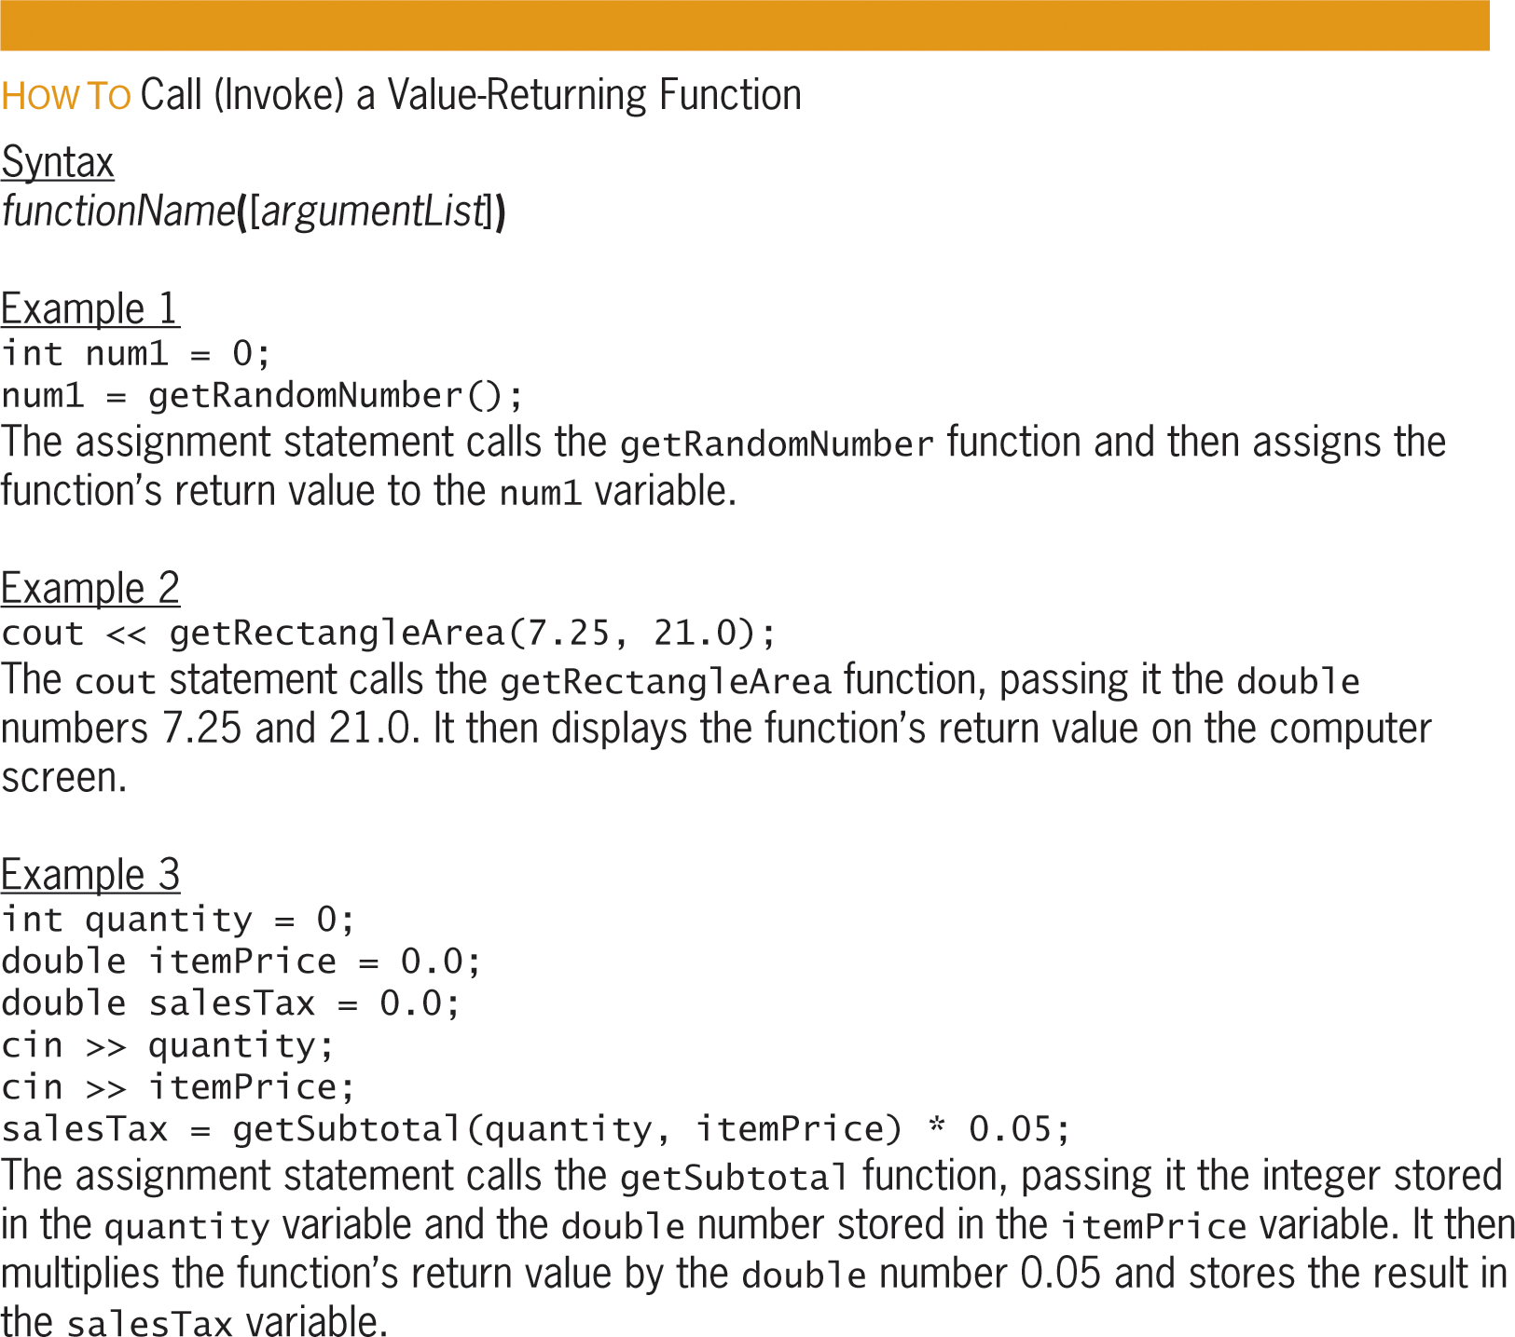
Calling a Function (cont’d.)
Figure 9-13 How to call (invoke) a value-returning function

Slide 35
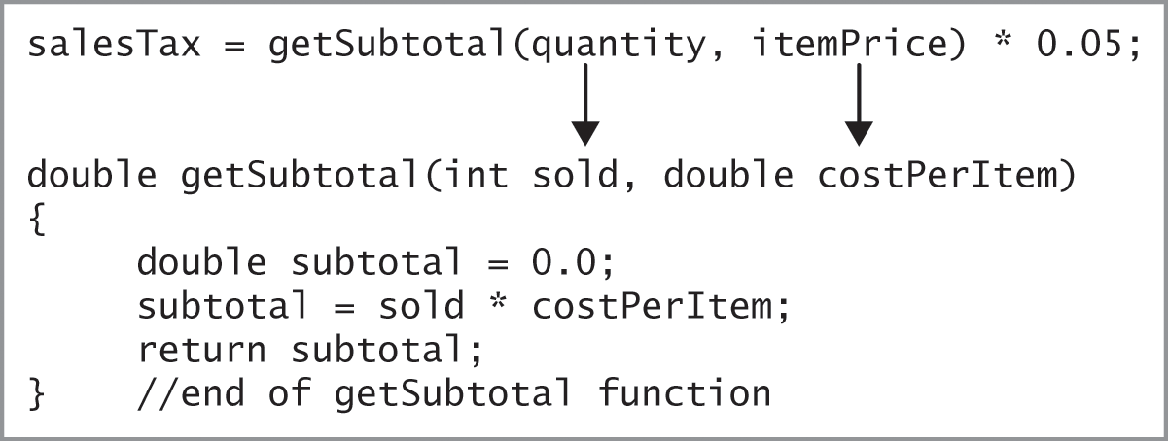
Calling a Function (cont’d.)
Figure 9-14 Function call and function definition

Slide 36
The Savings Account Program
The program allows the user to enter the initial deposit made into a savings account and the annual interest rate.
The program displays the amount of money in the account at the end of 1 through 3 years, assuming no additional deposits or withdrawals are made.

Slide 37
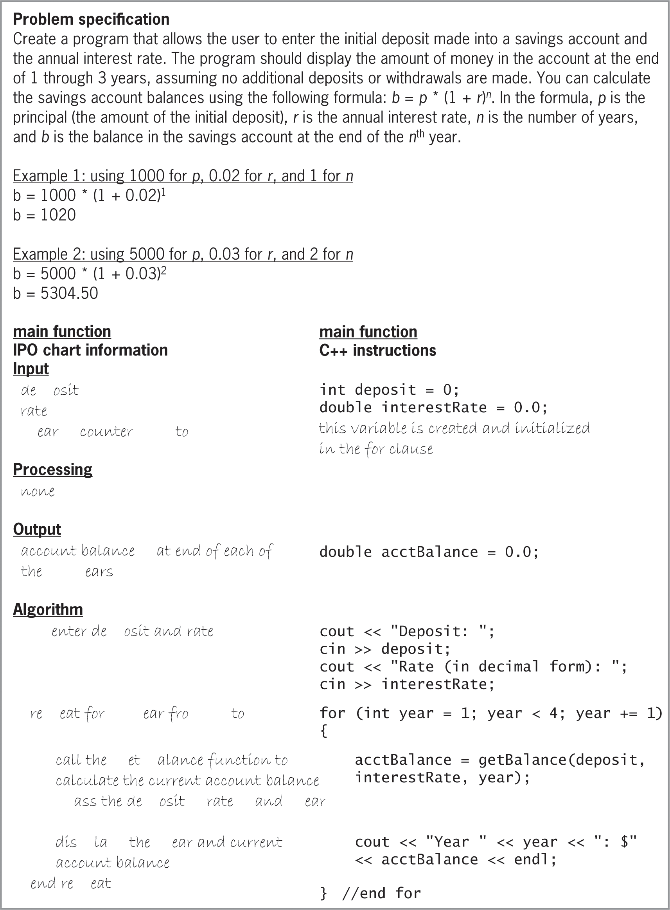
The Savings Account Program (cont’d.)
Figure 9-15 Problem specification, IPO chart information, and C++ instructions for the Savings Account Program

Slide 38
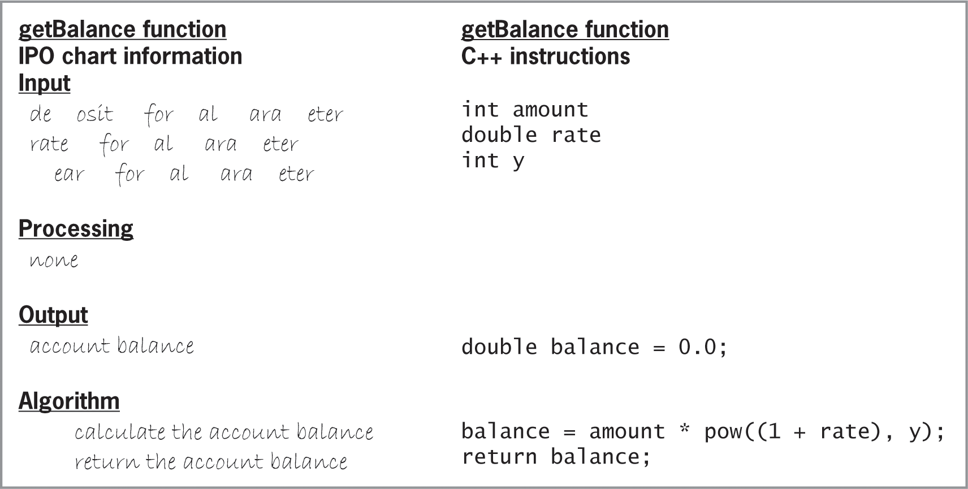
The Savings Account Program (cont’d.)
Figure 9-15 Problem specification, IPO chart information, and C++ instructions for the Savings Account Program

Slide 39
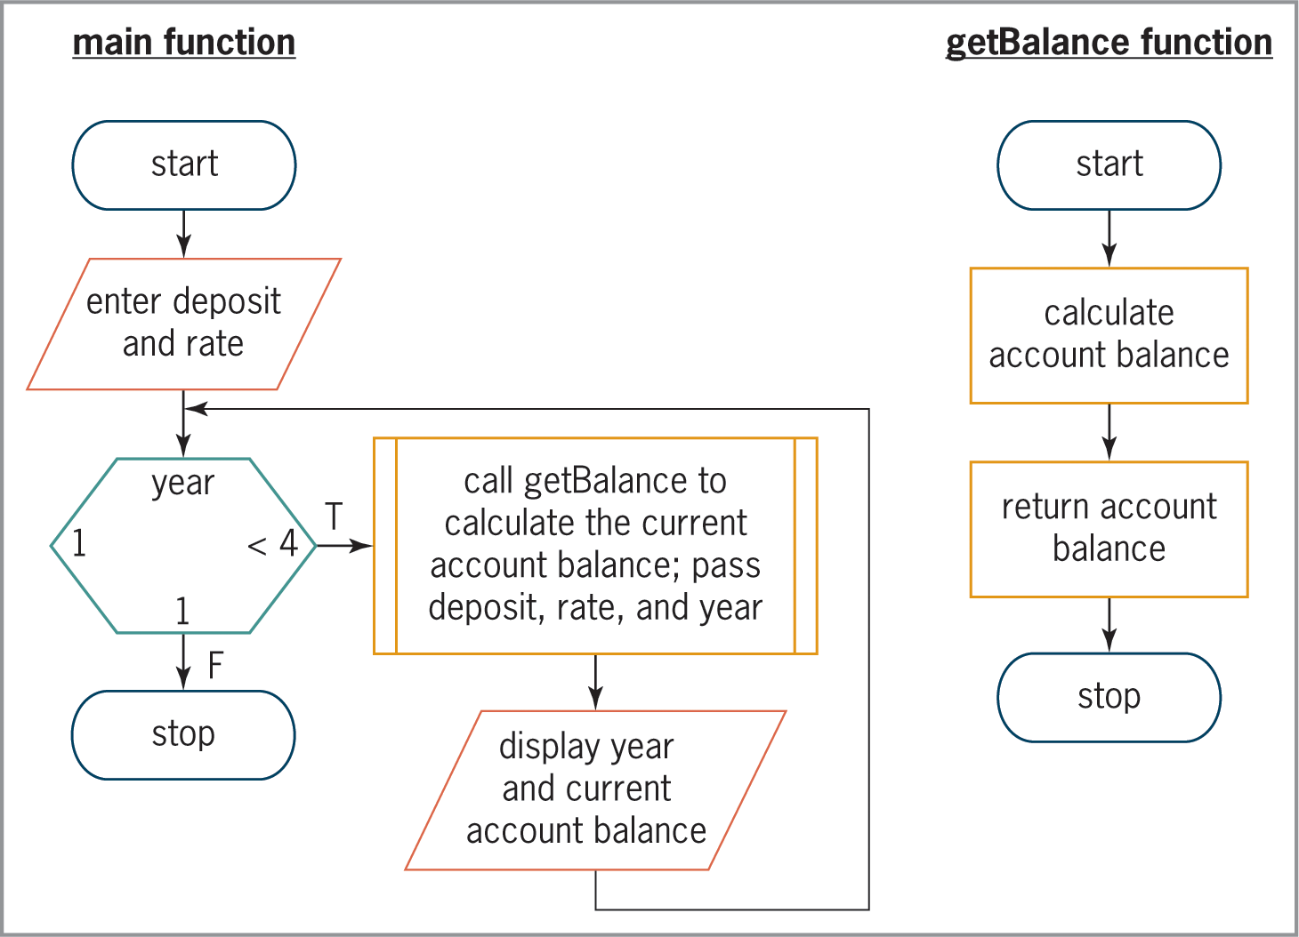
The Savings Account Program (cont’d.)
Figure 9-16 Flowcharts for the Savings Account Program

Slide 40
Function Prototypes
When a function definition appears below the main function, you must enter a function prototype above the main function
A function prototype is a statement that specifies the function’s name, data type of its return value, and data type of each of its formal parameters (if any)
Names for the formal parameters are not required
Programmers usually place function prototypes at beginning of program, after the #include directives

Slide 41
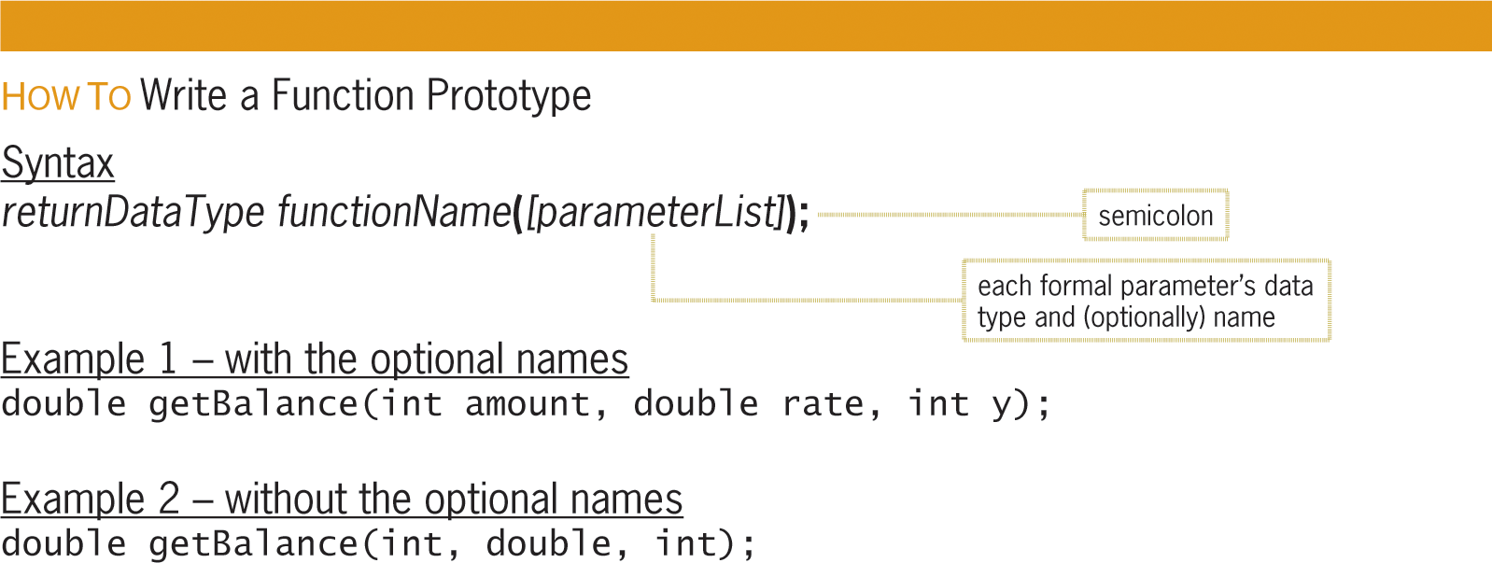
Function Prototypes (cont’d.)
Figure 9-17 How to write a function prototype

Slide 42
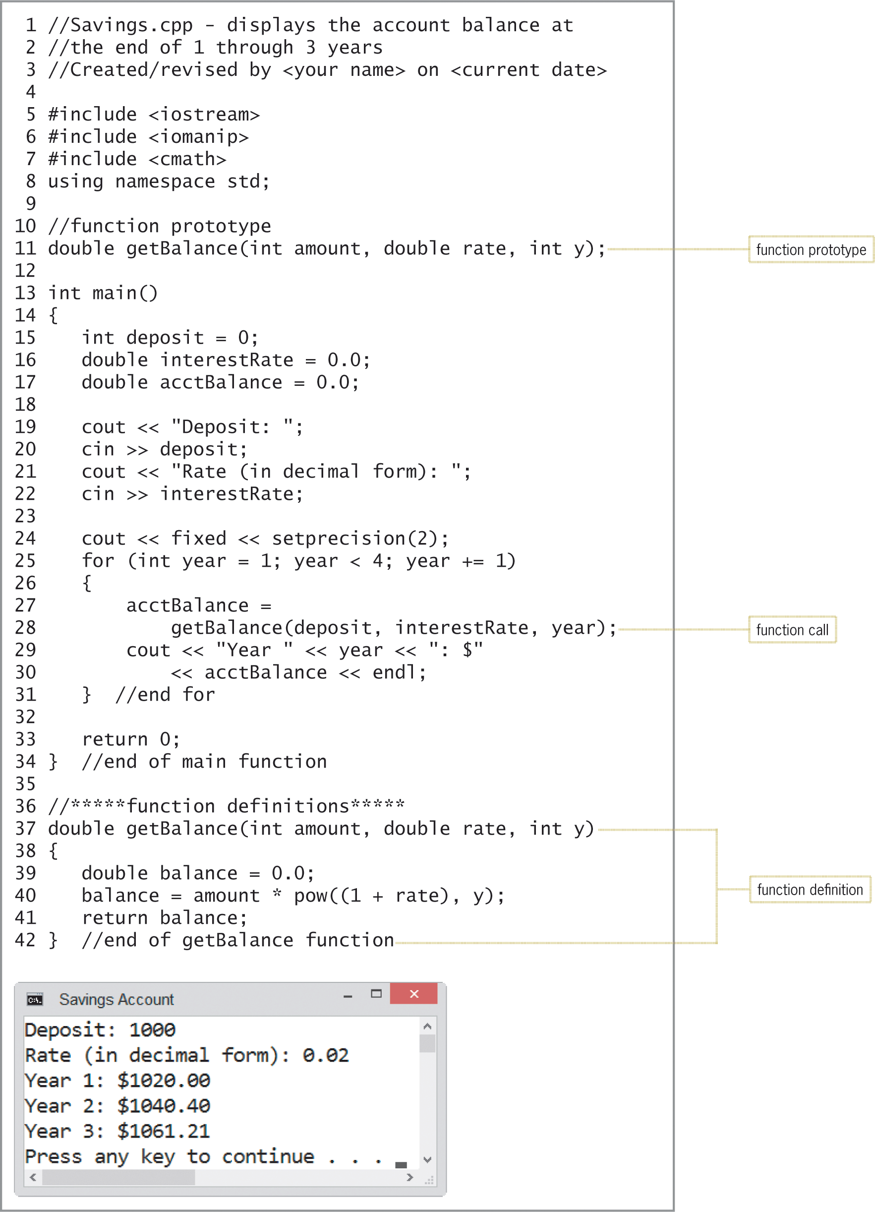
Completing the Savings Account Program
Figure 9-18 Savings Account Program

Slide 43
The Scope and Lifetime of a Variable
A variable’s scope indicates where in the program the variable can be used
A variable’s lifetime indicates how long the variable remains in the computer’s internal memory
Both scope and lifetime are determined by where you declare the variable in the program
Variables declared within a function and those that appear in a function’s parameterList have a local scope and are referred to as local variables

Slide 44
The Scope and Lifetime of a Variable (cont’d.)
Local variables can be used only by the function in which they are declared or in whose parameterList they appear
Remain in internal memory until the function ends
Global variables are declared outside of any function in the program
Remain in memory until the program ends
Any statement can use a global variable

Slide 45
The Scope and Lifetime of a Variable (cont’d.)
Declaring a variable as global can allow unintentional errors to occur
e.g., a function that should not have access to the variable inadvertently changes the variable’s contents
You should avoid using global variables unless necessary
If more than one function needs to access the same variable, it is better to create a local variable in one function and pass it to other functions that need it

Slide 46
Summary
Functions
Allow programmers to avoid duplicating code
Allow for large, complex programs to be broken into small, manageable tasks
Some functions are built into the language, and others are program-defined
All functions are either value-returning or void
A value-returning function returns one value
Value returned to statement that called the function
A void function returns no value

Slide 47
Summary (cont’d.)
Use the sqrt function to find the square root of a number
Use the pow function to raise a number to a power
Items in parentheses in a function call are called actual arguments
The rand function is used to generate random numbers
Returns an integer between 0 and RAND_MAX
srand function is used to initialize rand function
time function usually used as seed (starting point)

Slide 48
Summary (cont’d.)
Function definition composed of header and body
Header specifies function name, return data type, and formal parameter names and types (if any)
Data types and ordering of formal parameters must match data types and ordering of actual arguments
Body contains instructions for performing the function’s assigned task
Surrounded by braces ({})
return statement returns the result of an expression to the calling function

Slide 49
Summary (cont’d.)
You call a function by including its name and actual arguments (if any) in a statement
Variables in C++ are passed by value by default
A function prototype must be provided for each function defined below the main function
Scope of a variable indicates where in the program it can be used
Lifetime of a variable indicates how long it will stay in internal memory

Slide 50
Summary (cont’d.)
Local variables can be used only within the function in which they are declared or in whose parameterList they appear
Remain in memory until the function ends
Global variables can be used anywhere
Remain in memory until the program ends
If more than one memory location have the same name, position of the statement in which the name is used determines which location is used

Slide 51
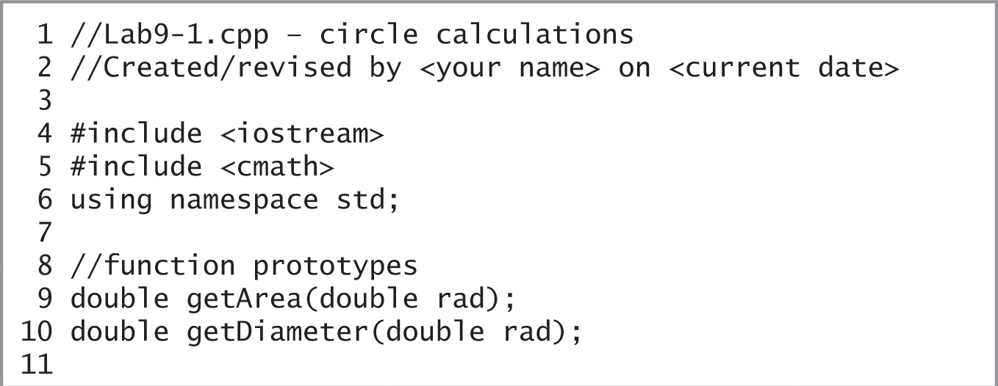
Lab 9-1: Stop and Analyze
Study the program in Figure 9-26, and then answer the questions
Figure 9-26 Code for Lab 9-1

Slide 52
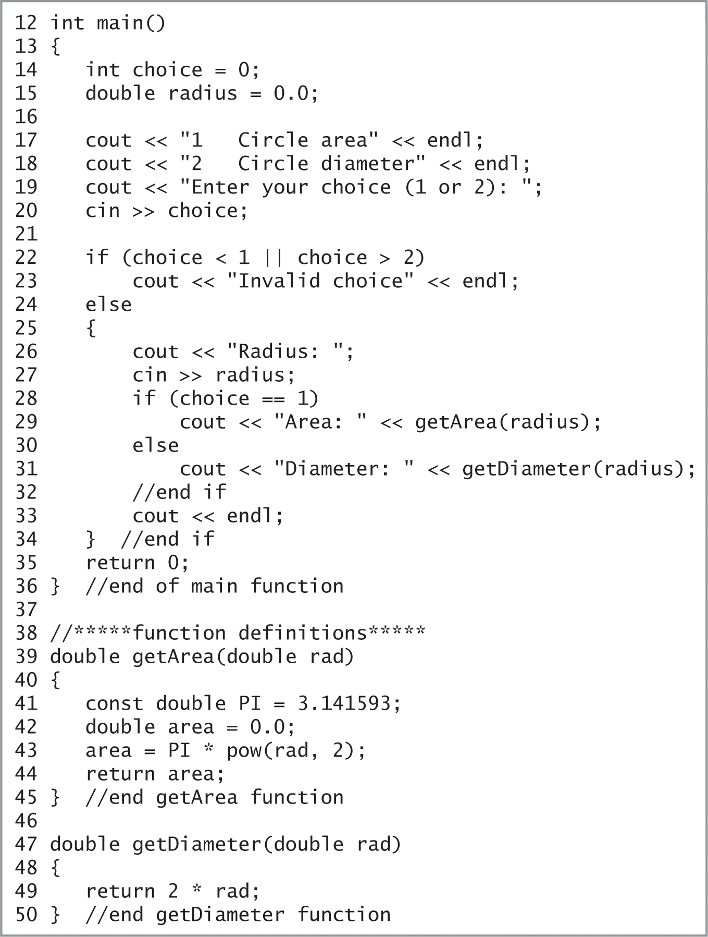
Lab 9-1: Stop and Analyze (cont’d.)
Figure 9-26 Code for Lab 9-1

Slide 53
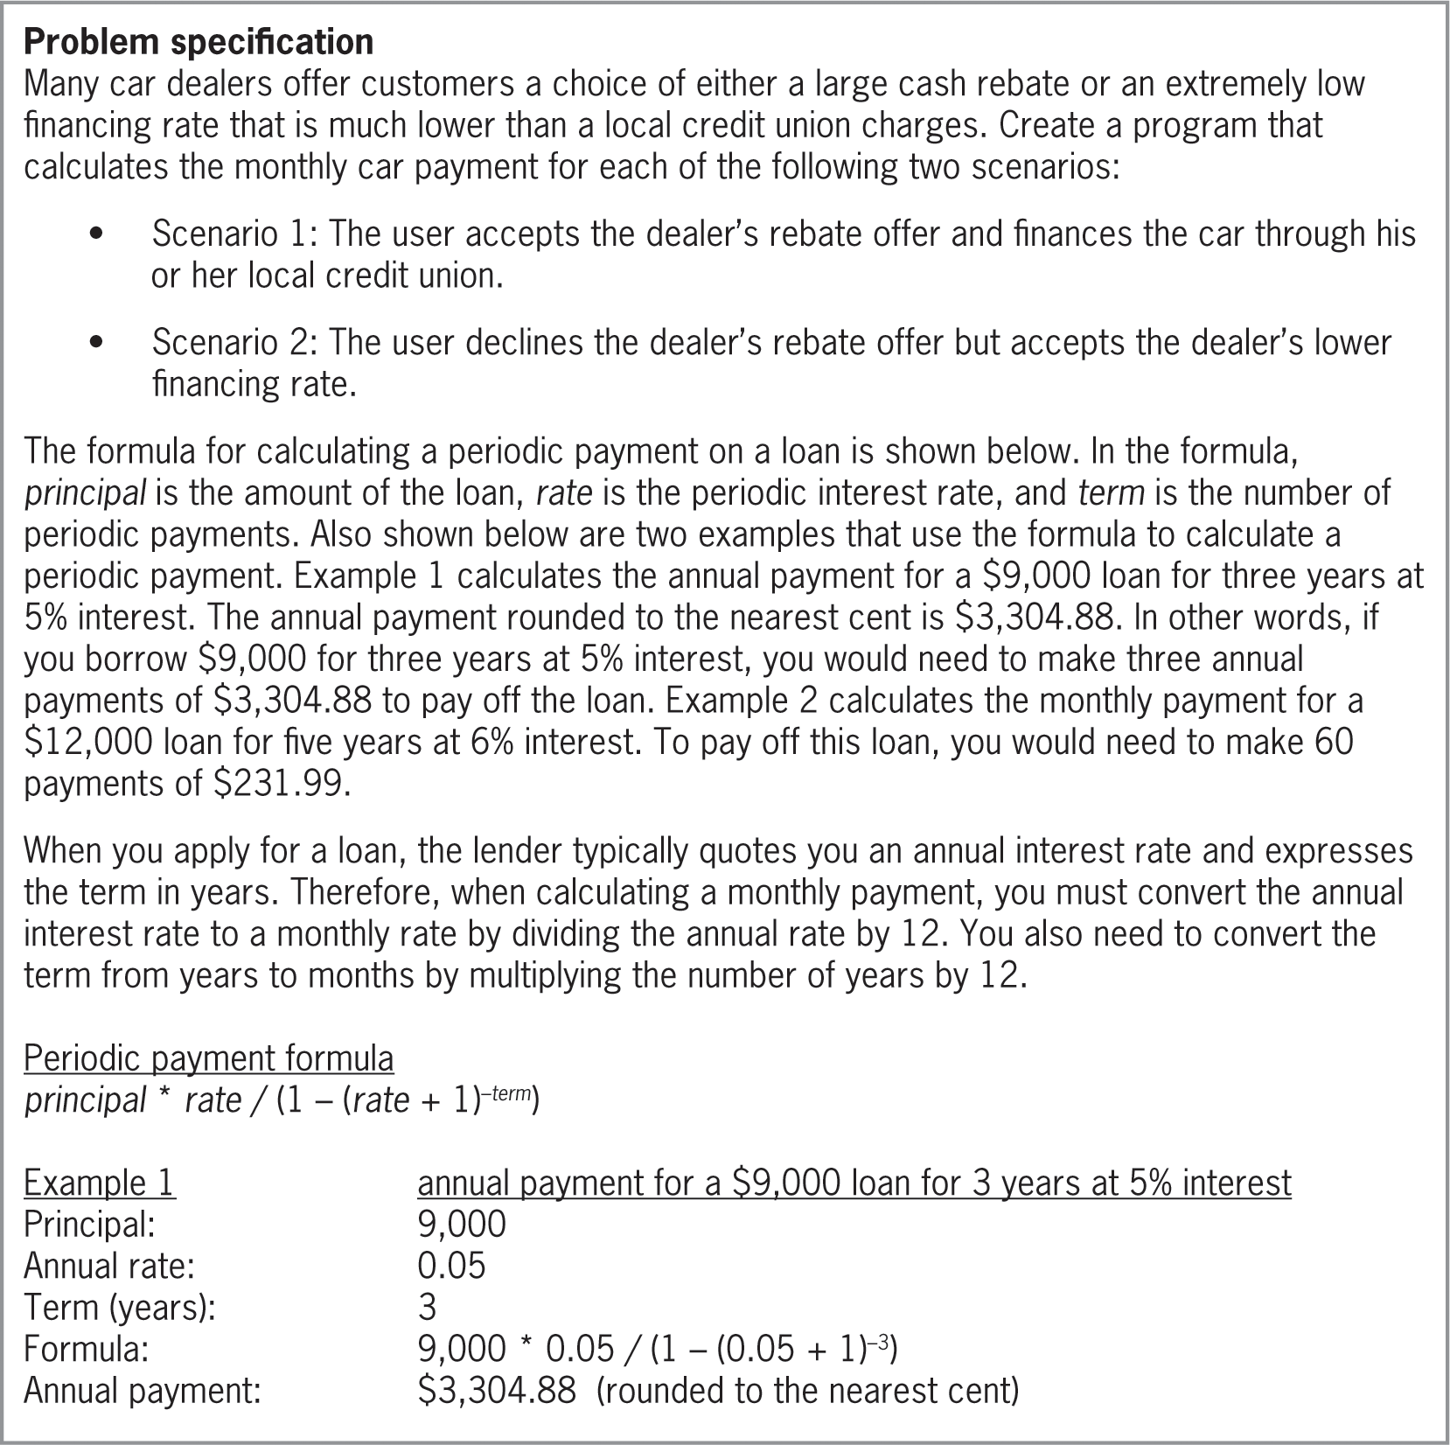
Lab 9-2: Plan and Create
Figure 9-27 Problem specification for Lab 9-2

Slide 54
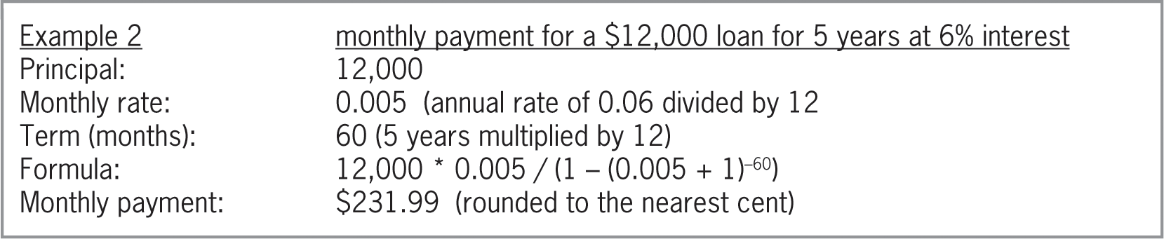
Lab 9-2: Plan and Create (cont’d.)
Figure 9-27 Problem specification for Lab 9-2

Slide 55
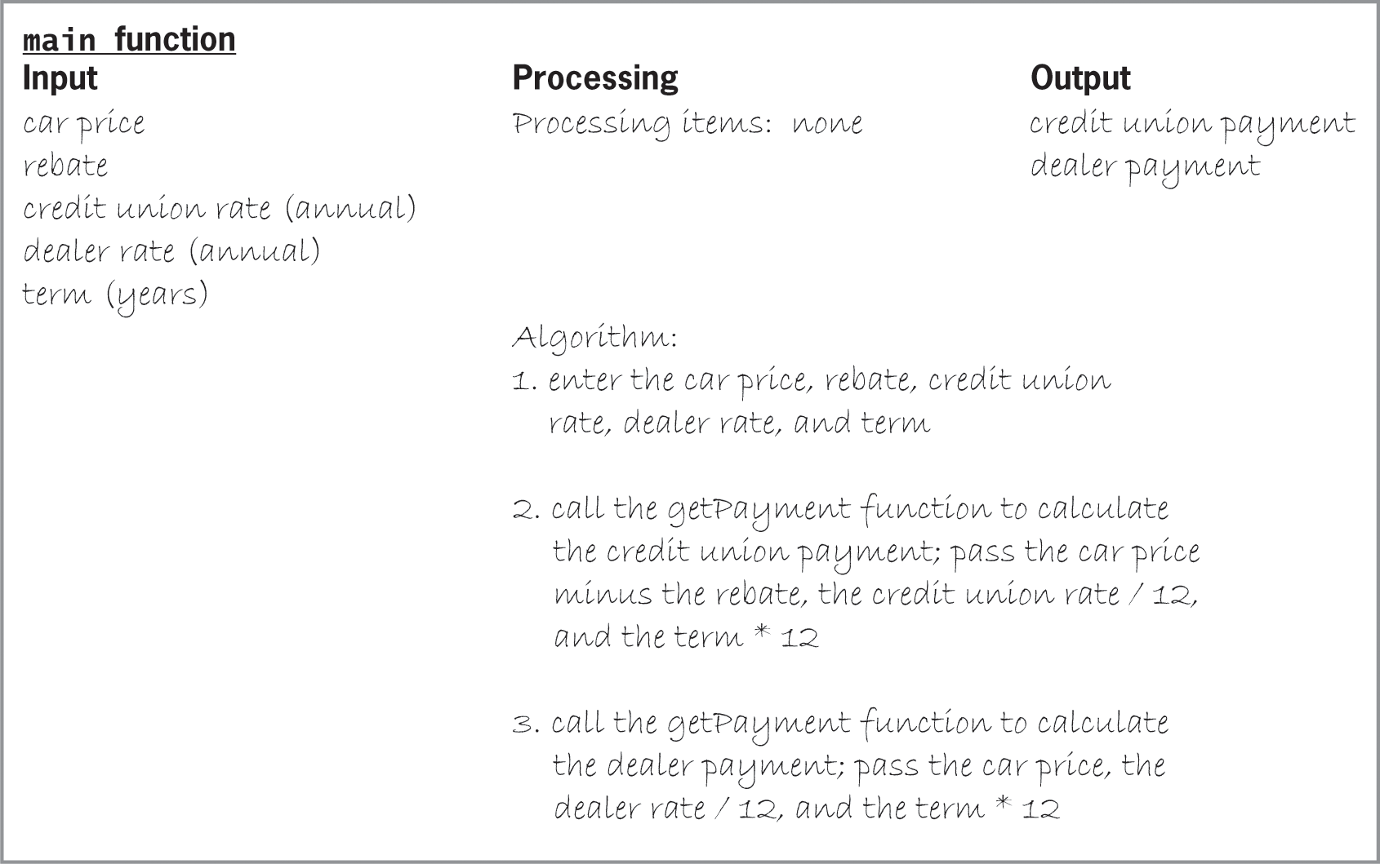
Lab 9-2: Plan and Create (cont’d.)
Figure 9-28 IPO chart for the main function

Slide 56
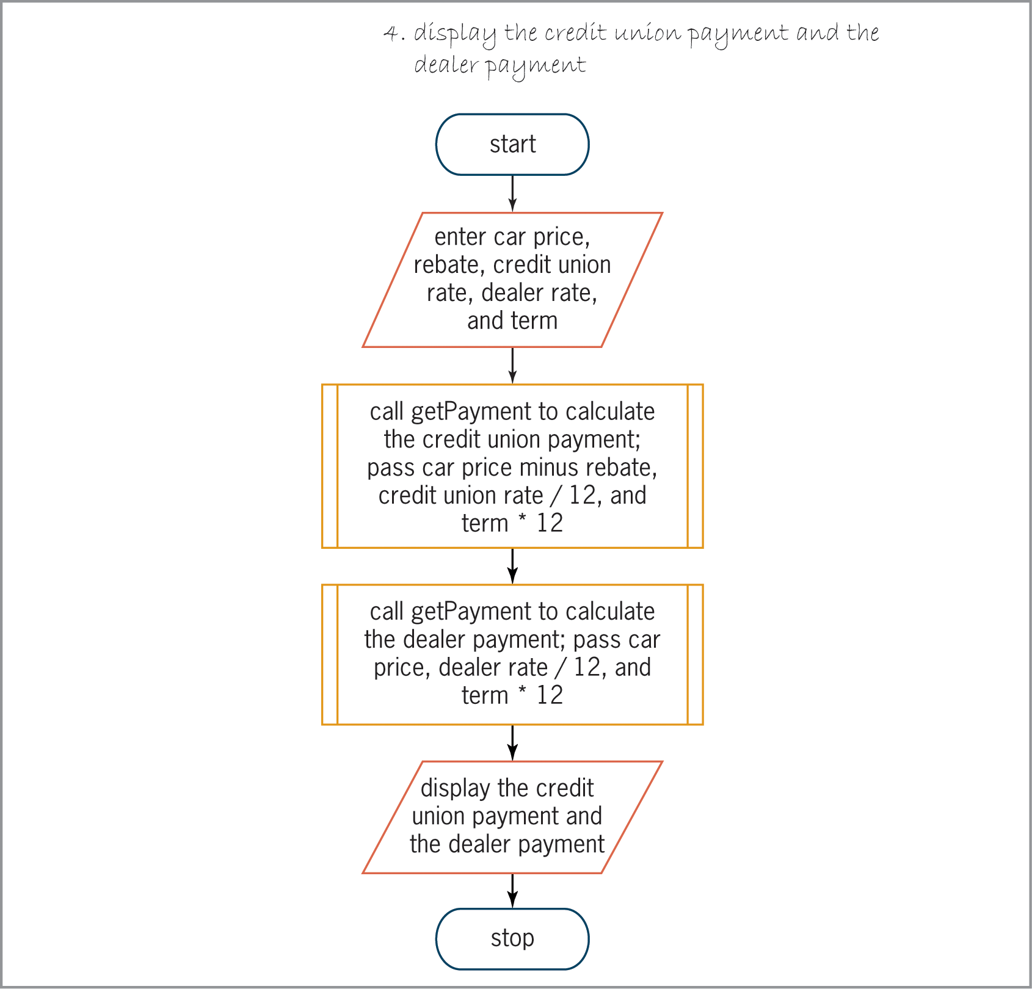
Lab 9-2: Plan and Create (cont’d.)
Figure 9-28 IPO chart for the main function

Slide 57
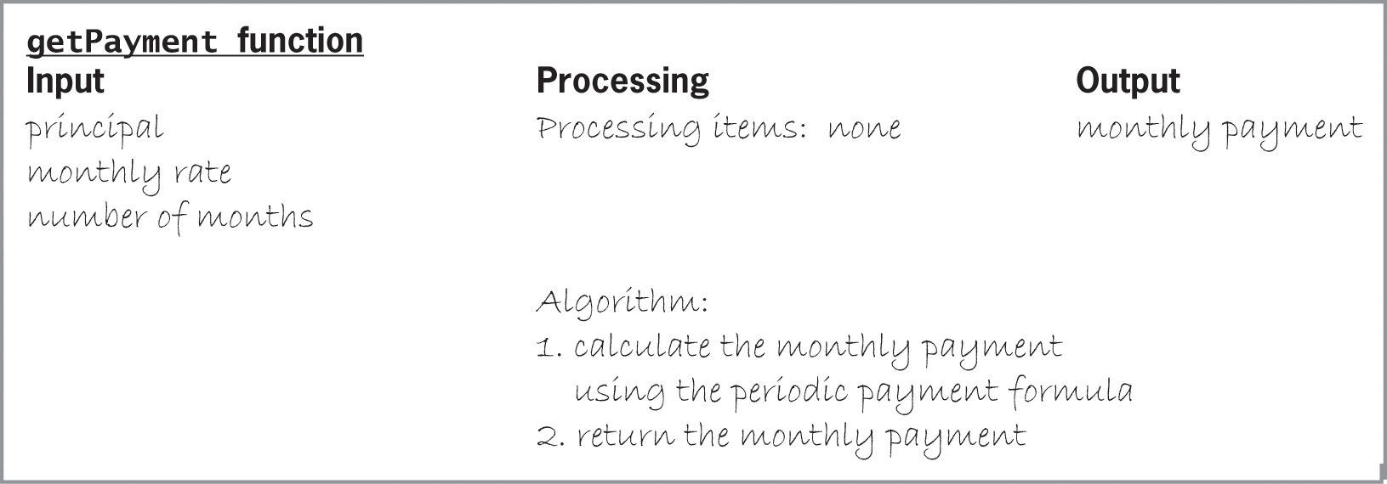
Lab 9-2: Plan and Create (cont’d.)
Figure 9-29 IPO chart for the getPayment function

Slide 58
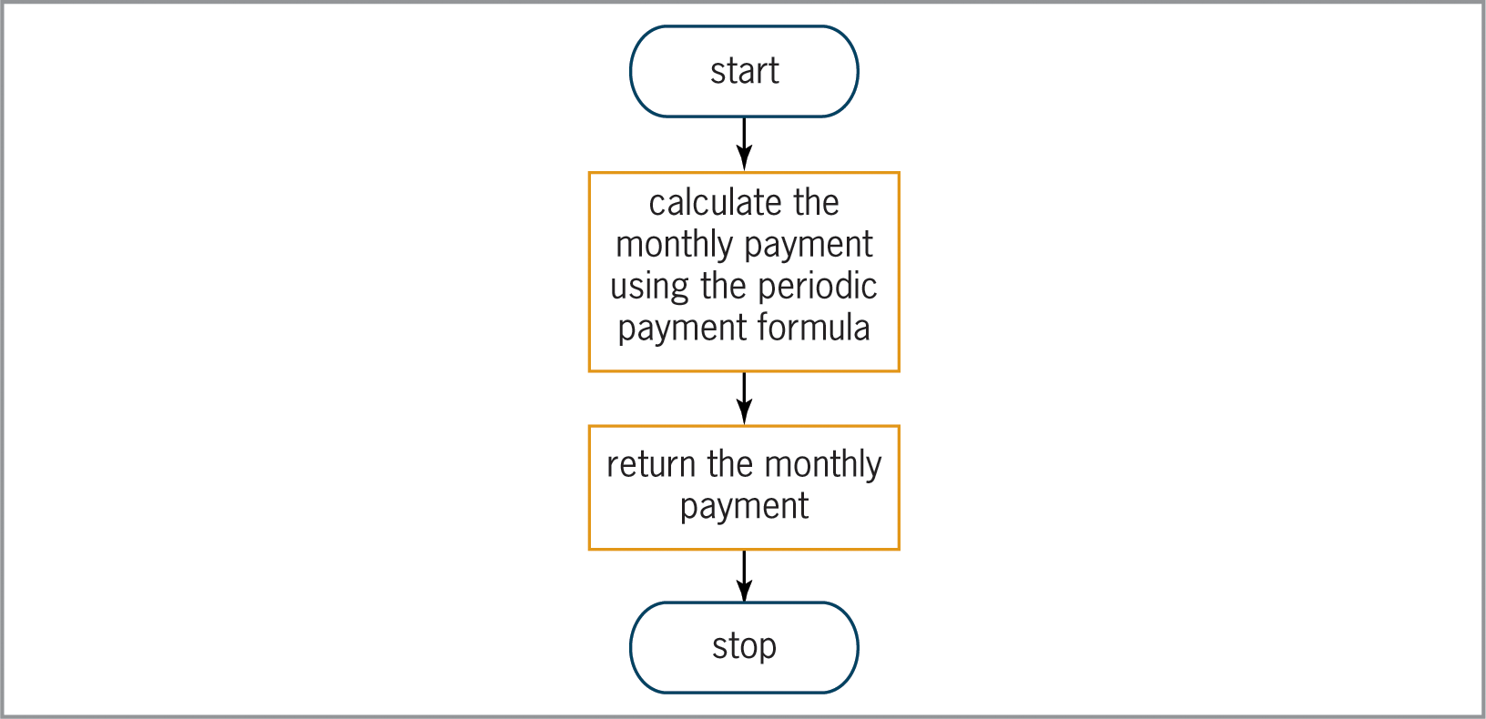
Lab 9-2: Plan and Create (cont’d.)
Figure 9-29 IPO chart for the getPayment function

Slide 59
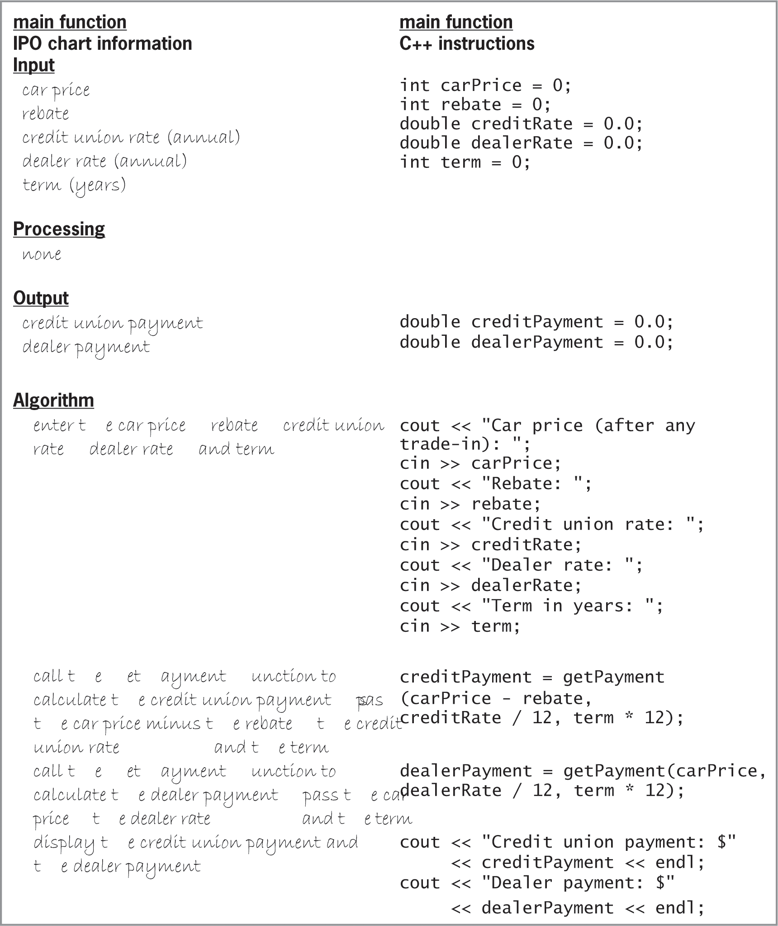
Lab 9-2: Plan and Create (cont’d.)
Figure 9-31 IPO chart information and C++ instructions for the main function

Slide 60
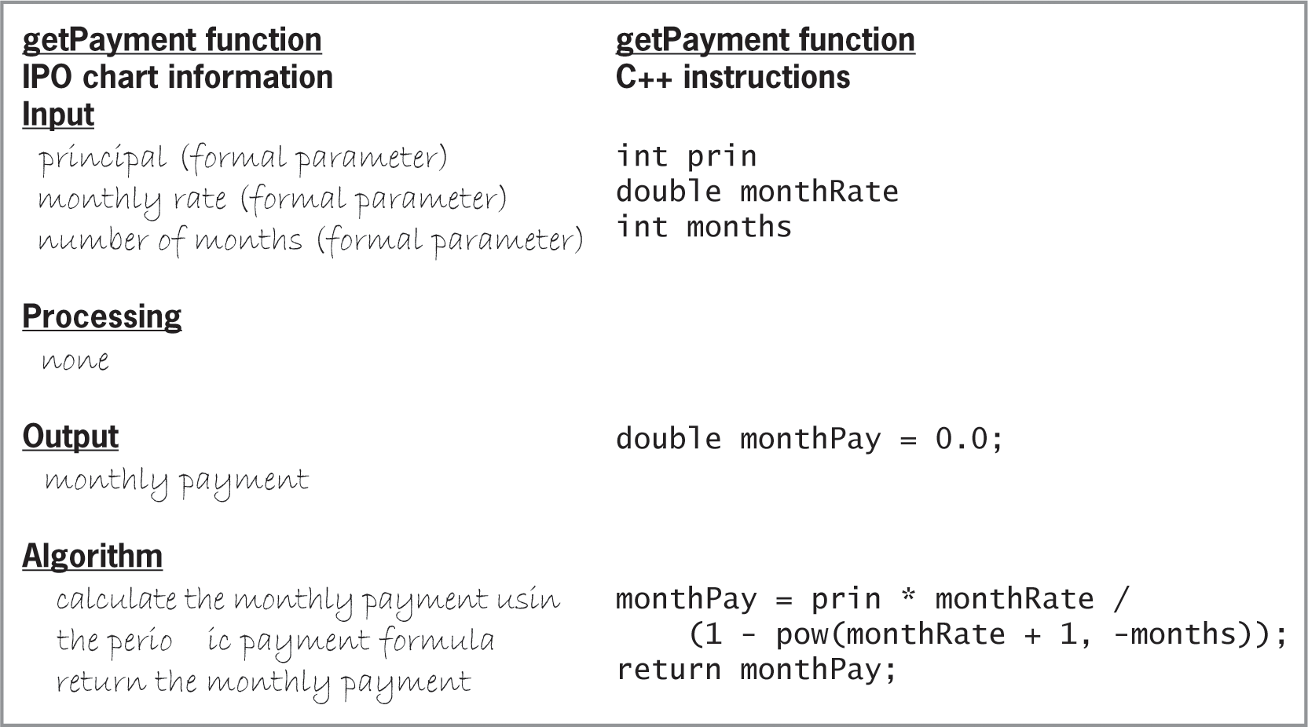
Lab 9-2: Plan and Create (cont’d.)
Figure 9-32 IPO chart information and C++ instructions for the getPayment function

Slide 61
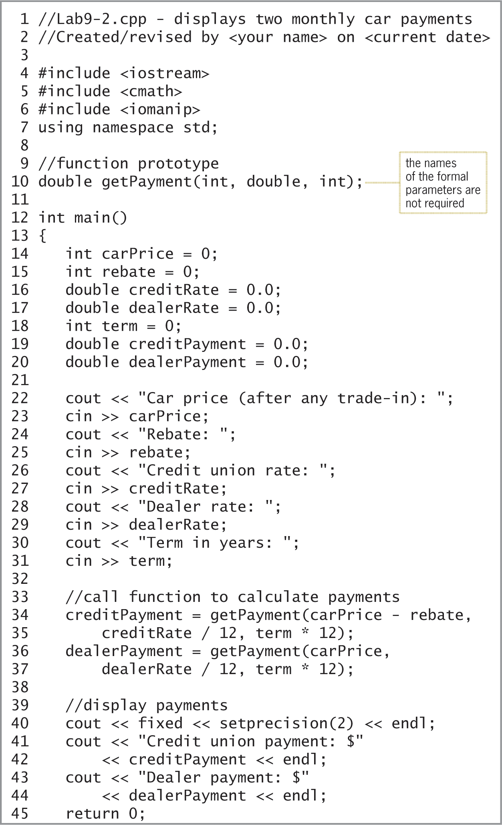
Lab 9-2: Plan and Create (cont’d.)
Figure 9-34 Beginning of finalized Car Payment Program

Slide 62
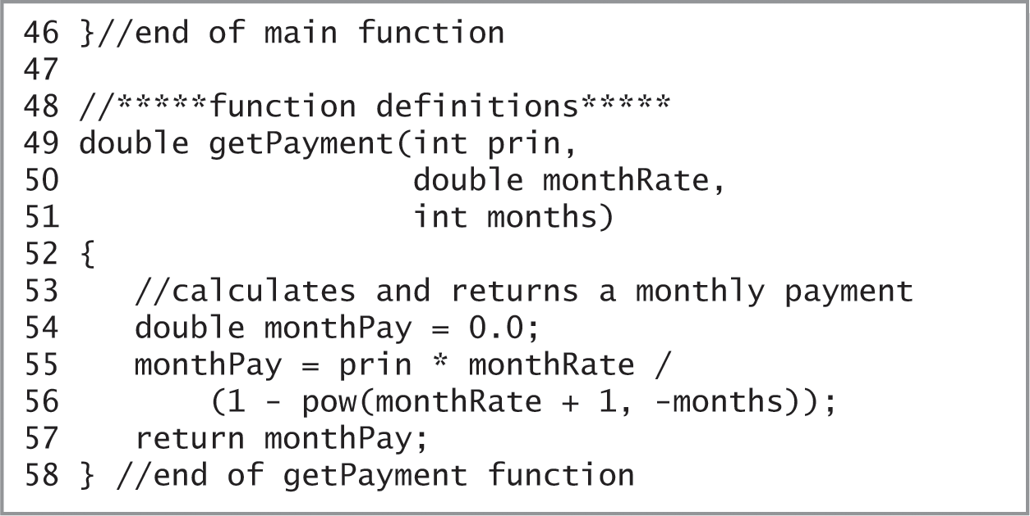
Lab 9-2: Plan and Create (cont’d.)
Figure 9-34 Completion of finalized Car Payment Program

Slide 63
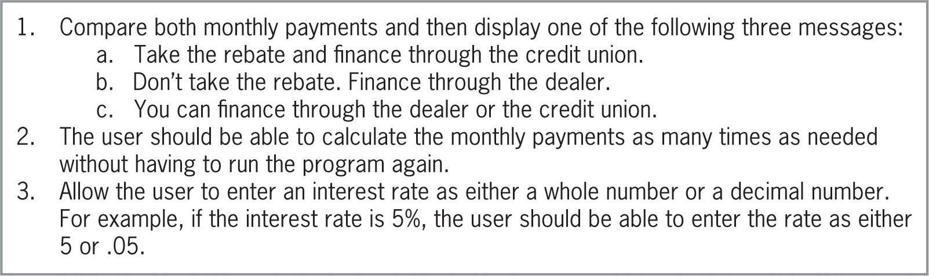
Lab 9-3: Modify
Modify the program in Lab9-2.cpp. Make the changes listed in Figure 9-35 below. Save the modified program as Lab9-3.cpp
Save, run, and test the program.
Figure 9-35 Modifications for Lab 9-3

Slide 64
Lab 9-4: What’s Missing?
The program is this lab should display the total due, given the quantity purchased and the item price.
Follow the instructions for starting C++ and opening the Lab9-4.cpp file. Put the C++ instructions in the proper order, and then determine the one or more missing instructions.
Test the program appropriately.

Slide 65
Lab 9-5: Desk-Check
Use the data shown in Figure 9-36 to desk-check the figure’s code. What current total will the code display on the screen?

Slide 66
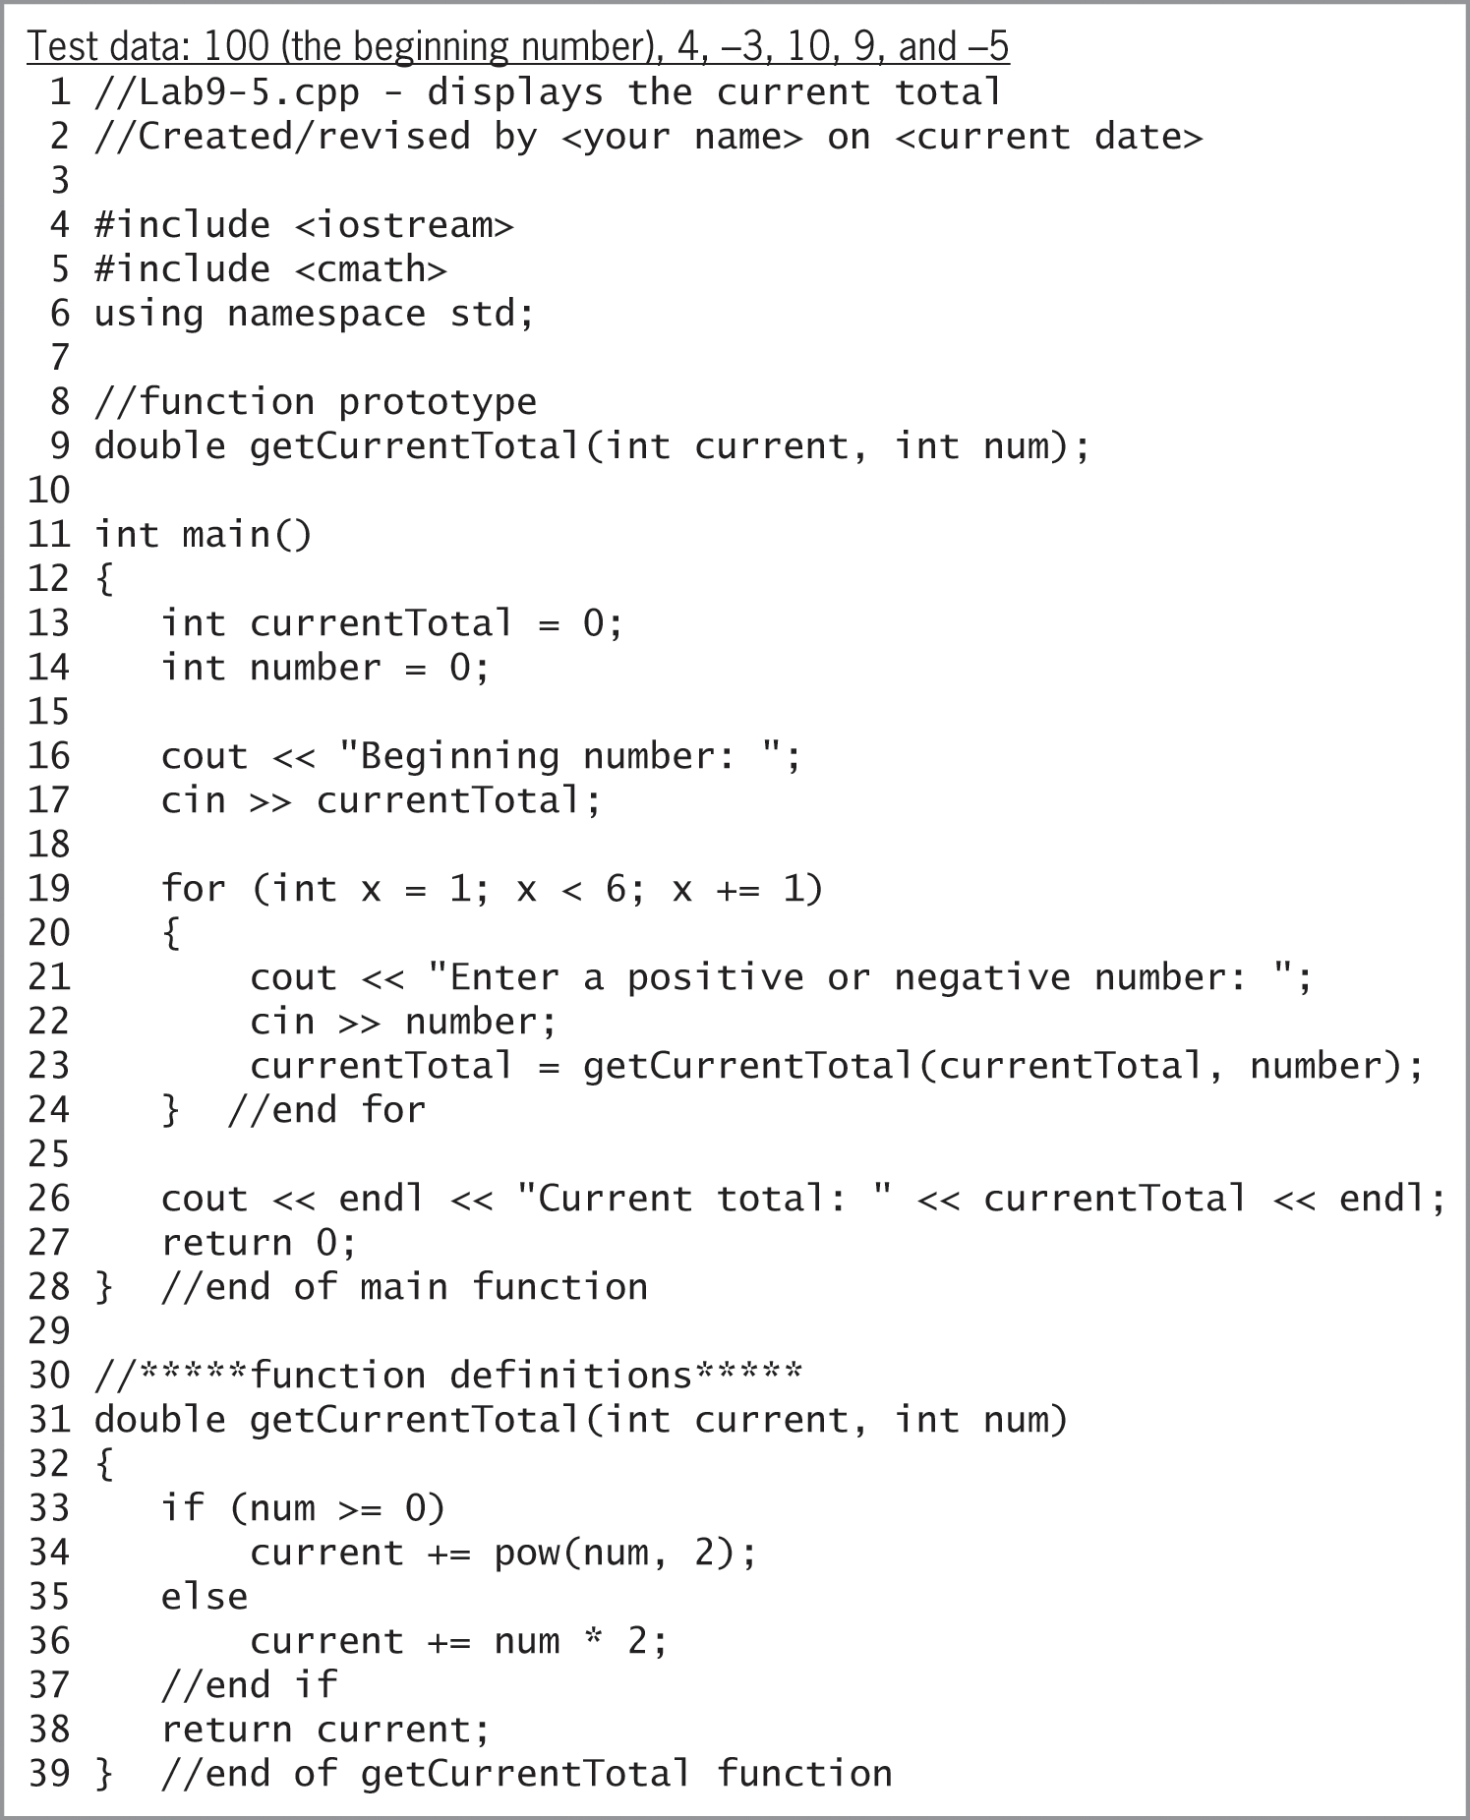
Lab 9-5: Desk-Check (cont’d.)
Figure 9-36 Test data and code for Lab 9-5

Slide 67
Lab 9-6: Debug
Test the program in the Lab9-6.cpp file using the data 20500, 3500, and 10 as the asset cost, salvage value, and useful life, respectively.
The depreciation should be $1700.00
Debug the program

